Slide 1
Package Collection Identifiers
Who What When Where Why How
Athena Hoeppner, University of Central Florida, Orlando
Christine Stohn, Ex Libris
NISO Plus 2021 Virtual Conference | 25 February 2021

Slide 2
Package IDs
What
Why
Where
How
When
Who

Slide 3
What do I mean by Package Identifiers?
The same ID for a given package across all ERMs and Knowledge Bases
Unique, persistent, structured identifier for a package collection in ERMs and KBs

Slide 4
Where would Package IDs be used?
Wherever a consistent ID for a collection would bring clarity and support automation.
Packages in ERMs and Knowledge Bases
On invoices
In discovery metadata

Slide 5
Why do I want Package IDs?
The library perspective
Problem 1: Matching licenses and invoices to ERM and KB entries
Problem 2: Migrating from one ERM to another
Problem 3: Understanding which single or combination of ERM or KB packages are the best fit and least work and best UX for a library’s mix of licenses

Slide 6
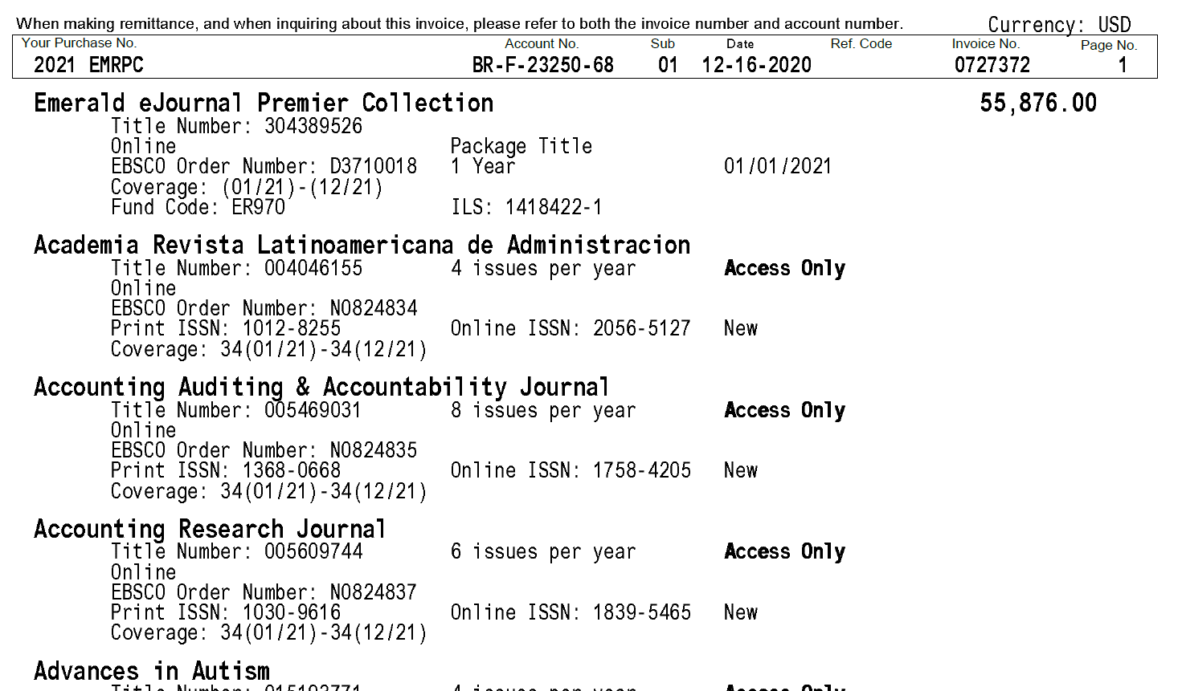
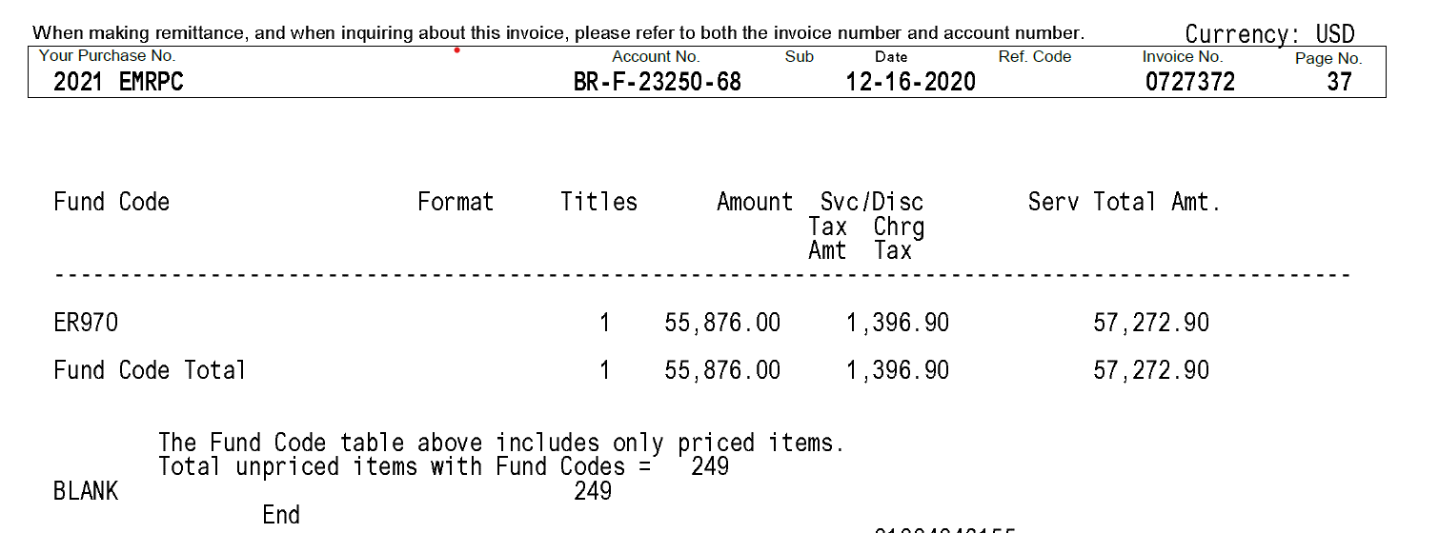
Problem 1: Invoice v KB
Package Title
Title List with Information
37 pages
249 titles

Slide 7
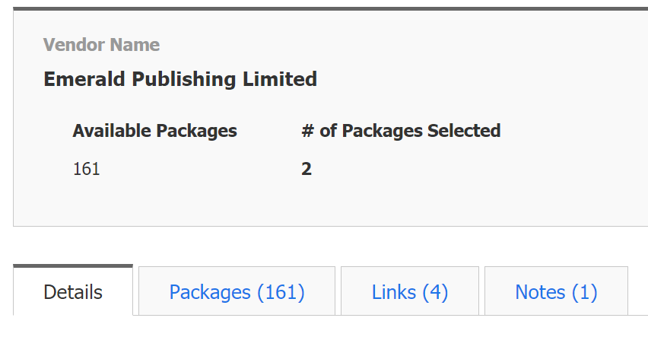
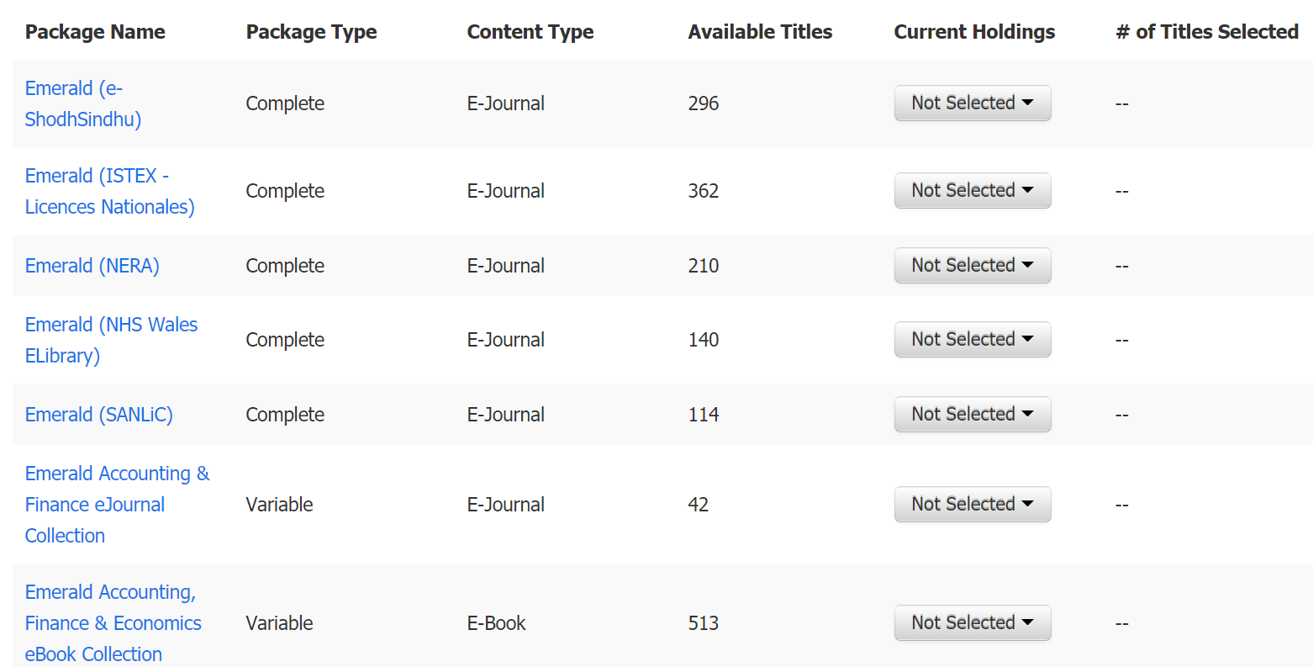
Problem 1: Invoice v KB
Vendor Name
Packages Names
Title Counts
161 Packages Available

Slide 8
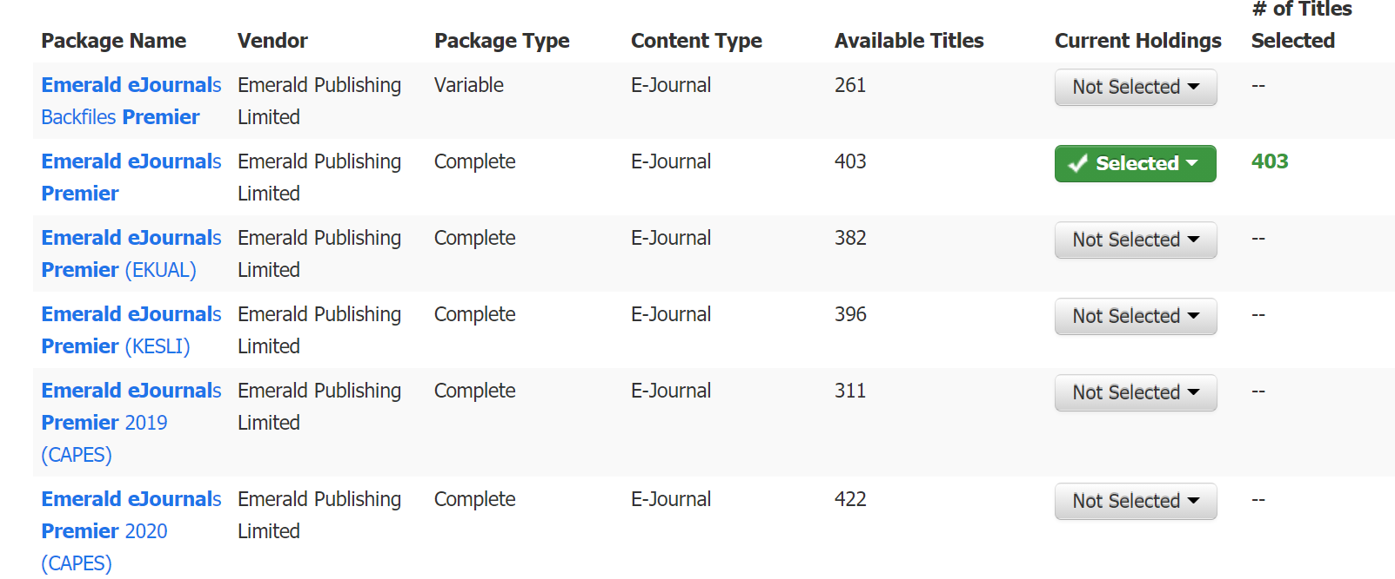
Problem 1: Invoice v KB
261 Titles v 403 Titles
Complete v Variable
Probably Consortia Custom Packages
Not to mention, holdings

Slide 9
A Problem of Scale and Duration
UCF’s KB Holdings

Slide 10
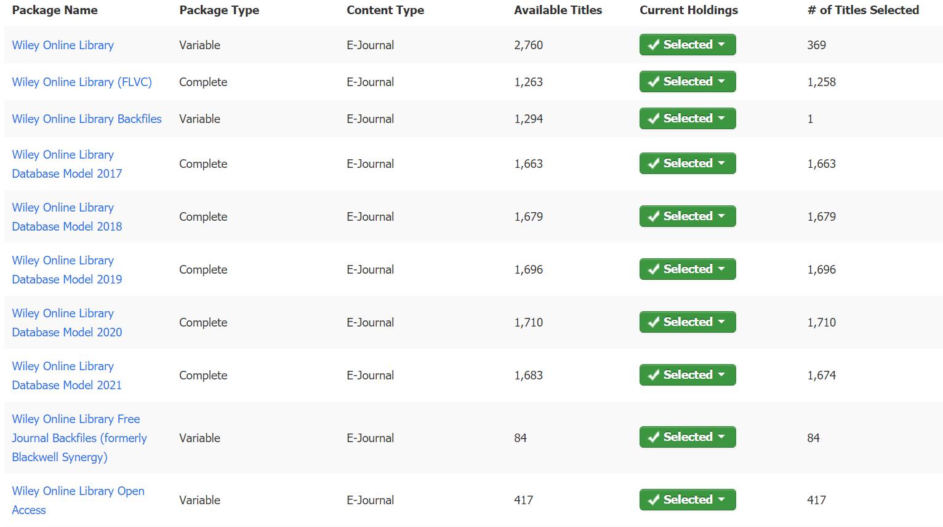
Different each year

Slide 11
How would Package IDs be used?
The library perspective
Use Case 1: Enabling a package in a link resolver
Use Case 2: Enabling MARC loads or other ILS / ERM integrations
Use Case 3: Enabling data sources in a discovery index and matching the searchable records to owned full text
Use Case 4: Establish predictable, potentially hierarchical, organization of packages in ERMs and KBs

Slide 12
Case 1: Enabling a package in a link resolver
Package EPLC-123457
Package ID: EPLC-123456
Package ID
EPLC-123456
EPLC-123457
EPLC-123458

Slide 13
Use Case 4: Potentially hierarchical
Complete v Variable

Slide 14
Use Case 4: Potentially hierarchical
Package ID
EPLC-12345-X
EPLC-12345-7
All Available Content
Specific
Sub-Set

Slide 15
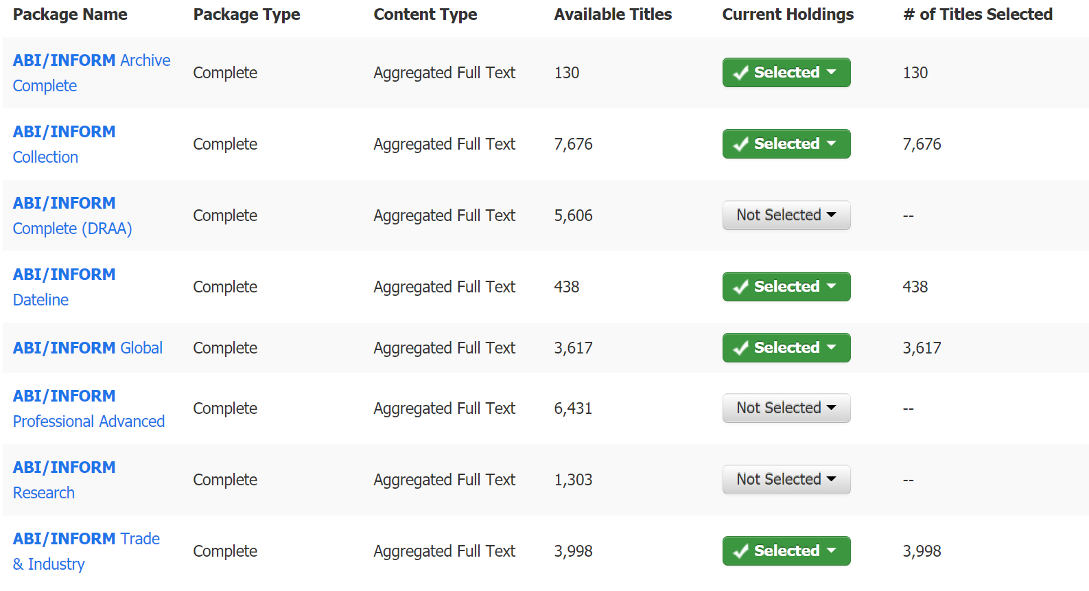
Use Case 4: Potentially hierarchical

Slide 16
Why do I want Package IDs?
The KB Provider perspective
Serve as a disambiguation data point
Easier communication in the supply chain
Verification of feeds from content providers
Stable way to track changes in packages
If included in Discovery feeds, could streamline the rights exchange between the KB and the discovery index
Recording packages in the license
Support for innovative features such as the provider zone in Alma – direct updates of KBs by providers

Slide 17
Why do I want Package IDs?
Serve as a disambiguation data point
And of course - KBART automation!
Basis for defining the next stage for automatically updating (sub) packages in KBs with library holdings

Slide 18
Are there challenges? Of course!
Restrospectively adding IDs to a Knowledge Base is not simple – package titles will have to be mapped to a package ID
Thousands of providers
An even higher number of packages
May lead to conflicts between KB and provider listings
Packages sometimes grew in a KB over time, with libraries influencing changes and additions
May lead to ID on the provider side not reflecting the exact same content on the KB side anymore
Rome was also not built in a day! Let‘s aim for improvement, it does not have to be perfect

Slide 19
When can Package IDs be real?
NISO project process
Submit a proposal
Work Item Title, Background and Problem Statement, Statement of work including scope, Partners and Participation, Timeline
Approval process
Forming the working group
Start working!
Submit proposed recommendations for comment
Reply to comments and submit final draft
Approval by the NISO topic committee
The goal is a practical solution that is workable by all stakeholders and provides benefits to all stakeholders

Slide 20
Who should be involved?
Knowledge Base vendors
Discovery vendors
Content providers
Electronic Resources Librarians
Metadata Librarians and experts
Identifier wonks
YOU

Slide 21
Let's start the discussion!
We would love to hear from you, either in our live discussion or by email:
Athena: athena@ucf.edu
Christine: christine.stohn@exlibrisgroup.com
Notes:
Google doc: https://docs.google.com/document/d/1MwIPNPtACywh79bQ3bGv0vWje9KlMvJemagoGcdi35o/edit

