Slide 1
Mapping the Open Access Book Supply Chain
NISO PLUS 2021
25 February 2021
Laura Ricci
Consultant
Clarke & Esposito
lricci@ce-strategy.com
www.ce-strategy.com

Slide 2
Project Overview
Clarke & Esposito was engaged by the Exploring Open Access Ebook Usage project to analyze and map the supply chain for OA books
Content Funders
Distributors
Content Platform
Sales Channels
Catalogs and Indices
End User Interfaces
Content Creators
Content Distribution
Usage Reporting
© CLARKE & ESPOSITO www.ce-strategy.com
2

Slide 3
GAP 1
Incentives are Aligned with Paid Access
Traditional book supply chains rely on sales as their central concept, with little incentive to traffic in free content
The OA books supply chain may still retain a sales component (e.g., paid-access digital versions of an OA title)
Opportunity: Both OA and paid-access providers will need to establish new shared incentives to support OA infrastructure
© CLARKE & ESPOSITO www.ce-strategy.com
3

Slide 4
GAP 2
Journal-based standards and models
are a poor fit for OA books
Books have different structures and distribution pathways from journals, and correspondingly different standards
Terminology and practice “borrowed” from OA journals can be a poor fit for a book (or chapter) and its OA status
Opportunity: OA books need standards that are fit for purpose
© CLARKE & ESPOSITO www.ce-strategy.com
4

Slide 5
GAP 3
Distribution processes do not easily handle changes to a title’s OA status
A book can become OA at any point in its life cycle
A book can become OA and versions may remain for sale
Opportunity: It is critical for the supply chain as a whole to work well from end to end to recognize metadata updates and properly ingest OA metadata
© CLARKE & ESPOSITO www.ce-strategy.com
5

Slide 6
GAP 4
Existing standards are used inconsistently, or are not fit for purpose
Providers are not consistent in use of OA metadata
COUNTER reporting standards are not quite built for reporting OA books usage to publishers / authors / funders
Opportunity: Develop new “best practices” around analyzing OA ebook usage
© CLARKE & ESPOSITO www.ce-strategy.com
6

Slide 7
GAP 5
Platform proliferation poses a challenge to usage aggregation and normalization
Users have many opportunities to view the same title on many platforms
Information available back from these platforms can vary widely
Regardless, even a slightly less imperfect picture counts as progress
Opportunity: Stakeholders Clarke & Esposito spoke with welcomed efforts towards creating more visibility into the usage of OA books
© CLARKE & ESPOSITO www.ce-strategy.com
7

Slide 8
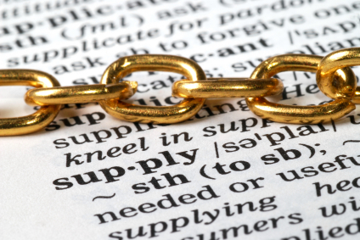
Thank You!
Draft Report Open for Public Review at https://educopia.org/data_trust/
© CLARKE & ESPOSITO www.ce-strategy.com
8

