Slide 1
How are PIDs & Preprints facilitating ownership of African scholarly content
Feb 22-25, 2021
Joy Owango
Executive Director TCC Africa & AfricArXiv Board Member

Slide 2
Claim: only 0.1% scholarly content is said to be from Africa
NOT TRUE instead, the work is not discoverable:
Regional bias in western journals’ editorial teams
African scholars are inclined to list western partner institutions instead of their African home institute
a large proportion of present and historical African scholarly output is in print
Bottlenecks in infrastructural network challenges and internet connectivity
Notes:
(source )- https://www.newtimes.co.rw/lifestyle/how-build-research-focused-universities-africa

Slide 3
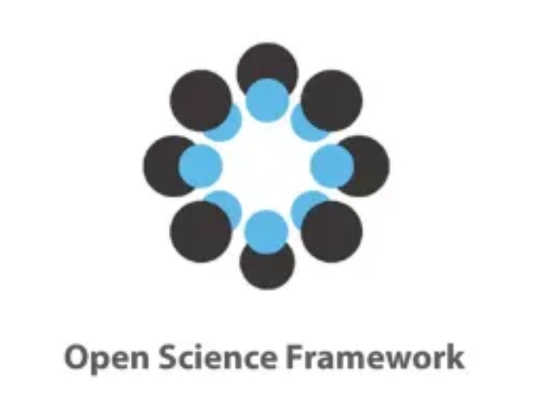
AfricArXiv is a community-led platform for African scientists of any discipline to present their research findings and connect with other researchers.
AfricArXiv is partnering with currently 6 established scholarly repositories
NEW!
NEW!
info.africarxiv.org/
Notes:
As we are working towards building our own repository that is
owned by the African Science community
hosted on African territory
open source
open access
free for users -Hosting institution based in Africa for African researchers to deposit and save their research work -Aim for African research Infrastructure- any scientist in the continent can access what is in the server.
- to ensure accessibility and discoverability for any scientist in the continent

Slide 4
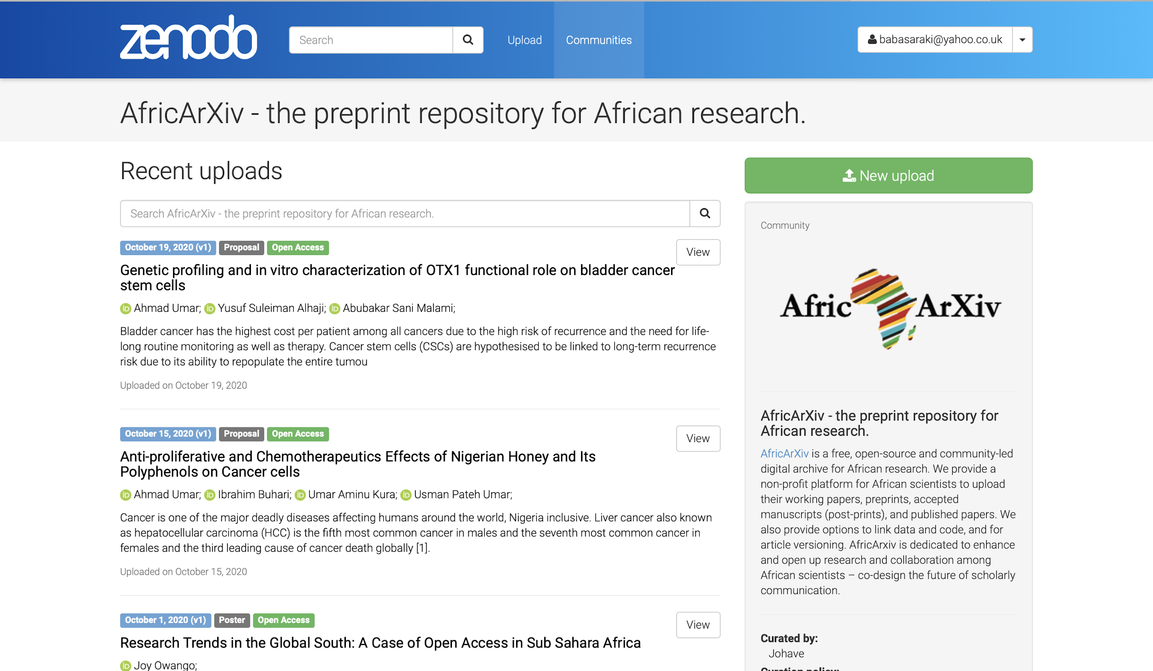
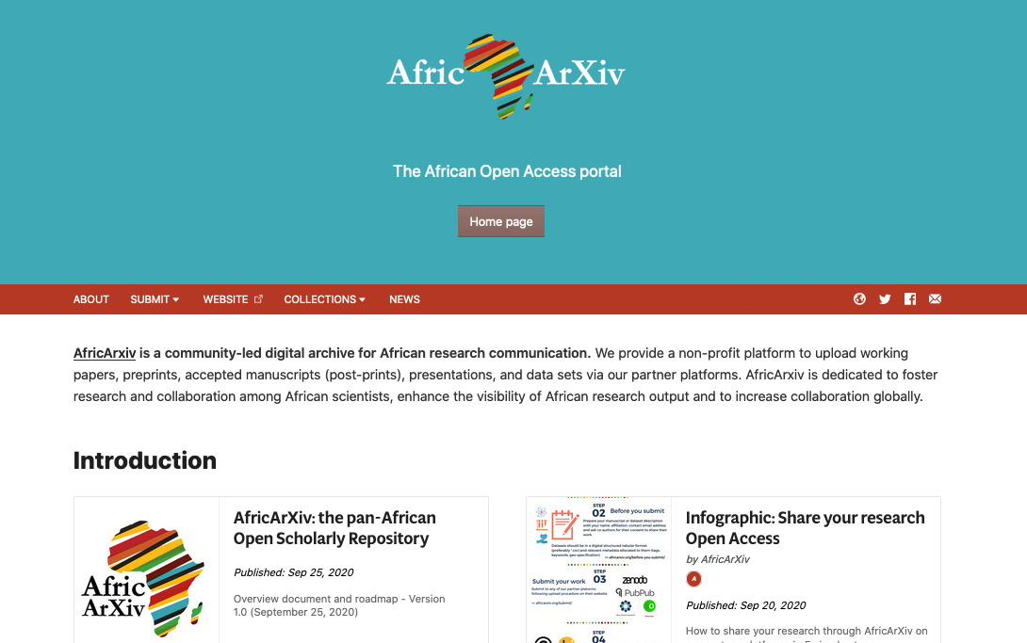
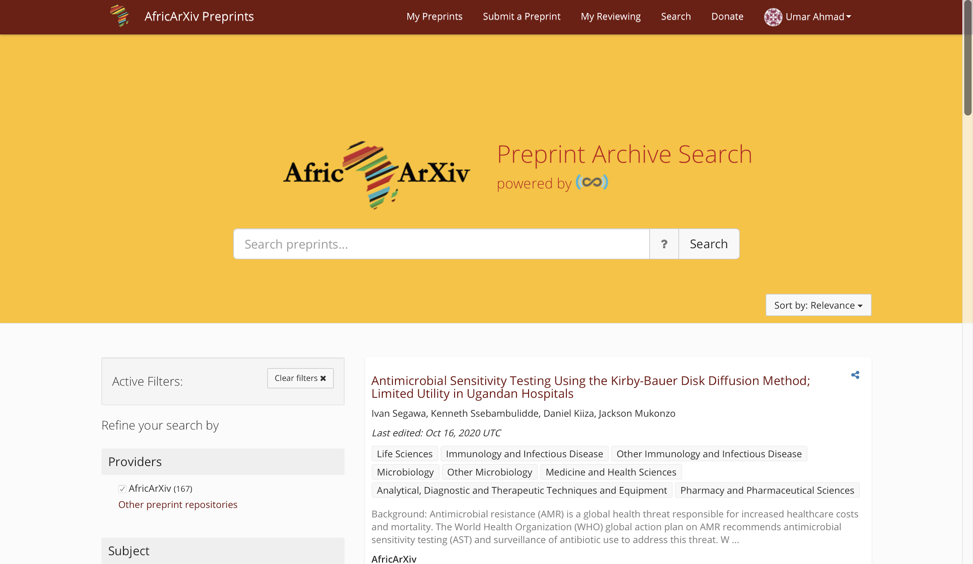
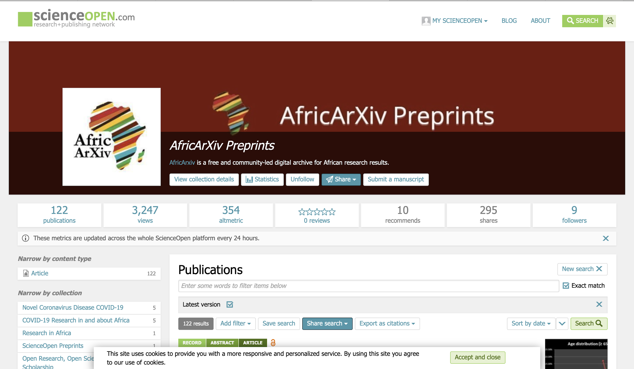

Slide 5
How identifiers are changing the landscape
Relevant identifiers for an African scholarly context
ORCID for individual researchers
ROR for institutions
DOI for scholarly output
Notes:
Xx ORCID ID with African scholars (where African affiliation is listed)
ORCID institutional consortia
XX African Institutions with ROR identifiers
AfricArXiv enables doi assignment
XX accepted works with registered doi until today

Slide 6
Language Diversity
We need language diversity in science.
We need a common language to connect.
We suggest a balanced use of both while using as much technology for support as possible.

Slide 7
AfricArXiv accepts submissions in African languages
AfricArXiv users can submit their work in Swahili, Yoruba, Igbo, Afrikaans, Wolof, Fon, Amharic, or any other national or regional African language.
About 2,000 languages are spoken in Africa.
A high amount of traditional and indigenous knowledge
Notes:
Submit your research article manuscripts for immediate access and visibility of your research results. Accepted and supported by research funders, employers and also more than 80% of the global journals (most publishers). Preprint repositories are now an integral part of Open Science

Slide 8
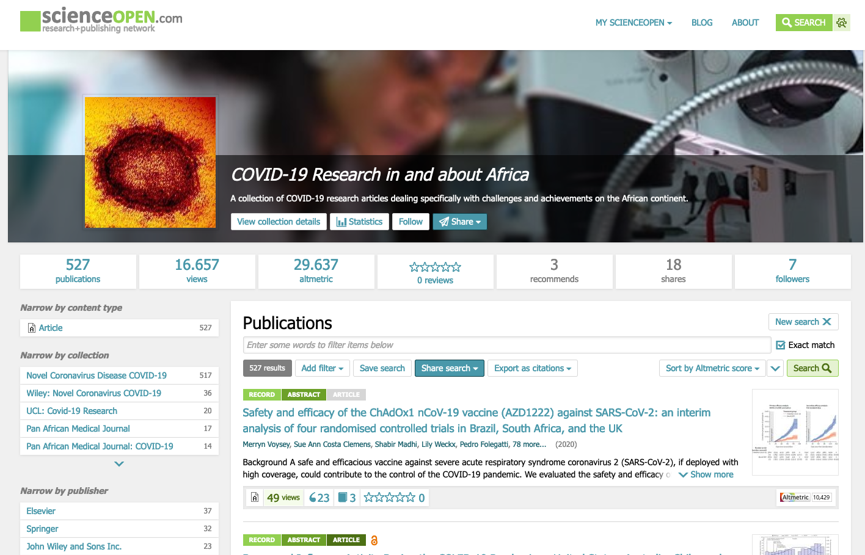
scienceopen.com/collection/COVID19_Africa
Notes:
On ScienceOpen, we are curating a collection of currently 379 research articles on COVOD19 from and about Africa - new articles are automatically being added to this collection. these contain some articles that were submitted to Africarxiv - it's a collection across publishers

Slide 9
Opportunities
Increased digitally discoverability of African content
Build our own scientometrics based on measurable outputs
Working with established infrastructure providers for long term digital storage
Evidence-based policy in M&E of output contextualised to the needs of African research stakeholders

Slide 10
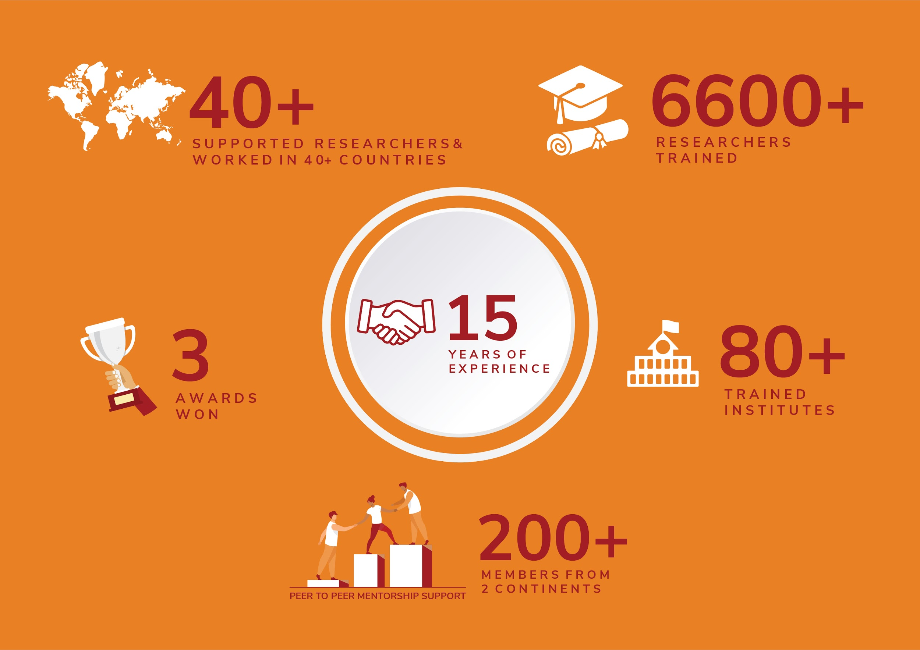
Capacity building on preprints and PIDs
Once identifiers are effectively used on the continent, we will have maximum ownership of African continent and increased visibility.

Slide 11
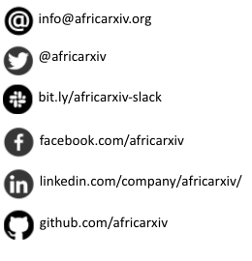
African Scholar?
Let us know how we can support you
info.africarxiv.org

