Slide 1
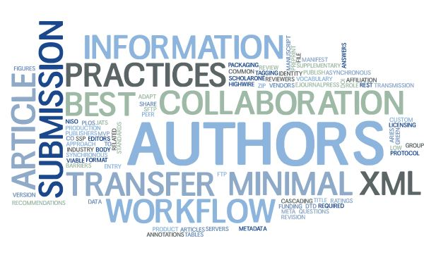
MECA
Manuscript Exchange Common Approach
Tony Alves
Scholarly Publishing Free Agent
tonyhopedale@gmail.com
@OccupySTM
Stephen Laverick
Director, Green Fifteen Publishing Consultancy
stephen@greenfifteen.org
@R2Stephen

Slide 2
What is MECA?
A method of manuscript exchange
System-to-system
To/from preprint servers
To/from vendors
Original team in 2017 → identified a need to transfer manuscripts between systems
Aries Systems | Clarivate | eJournalPress | HighWire Press | PLOS

Slide 3
What is MECA?
NISO MECA Working Group announced May 2018 and expanded team
Aries Systems | Clarivate | eJournalPress | HighWire Press
PLOS | American Chemical Society | American Physical Society | Cold Spring Harbor
eLife | IEEE | Green Fifteen Consultancy | Jisc
Journal of Clinical Investigation | National Library of Medicine | Springer Nature | Taylor and Francis

Slide 4
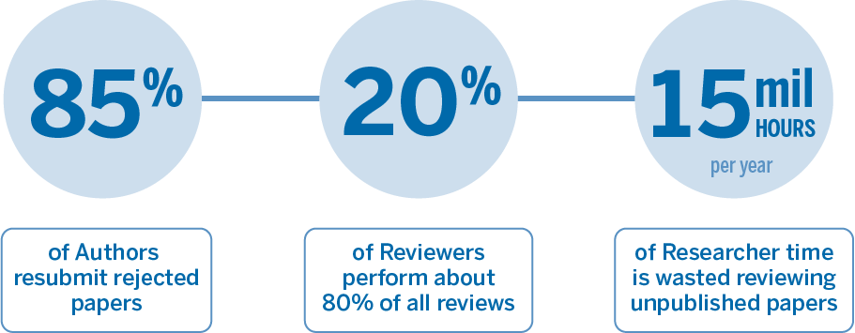
Time and Effort Wasted
Inside Higher Ed. (n.d.). Retrieved August 5, 2019, from https://www.insidehighered.com/views/2017/03/28/academics-shouldnt-focus-only-prestigious-journals-essay
Kovanis, M., Porcher, R., Ravaud, P., & Trinquart, L. (2016, November 10). The Global Burden of Journal Peer Review in the Biomedical Literature: Strong Imbalance in the Collective Enterprise. Retrieved August 6, 2019, from https://www.ncbi.nlm.nih.gov/pmc/articles/PMC5104353/
Scholar. (n.d.). Retrieved August 6, 2019, from https://www.aje.com/arc/peer-review-process-15-million-hours-lost-time/

Slide 5
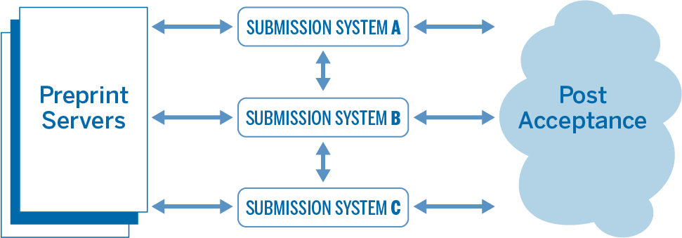
Use Cases
Transfer manuscripts and reviews between journals
Transfer manuscripts between preprint servers and journals
Import manuscripts from authoring systems / tools to submission systems
Export manuscripts from submission systems to other services, e.g. repositories, compositors, etc.

Slide 6
Principles
Facilitate transfer between publications and platforms
Journals and Authors set the rules on what is transferred
Package may not be a complete submission
Systems can define Minimal Viable Product to start a submission on the receiving site
Protocol based on best practices and industry standards
Not a central service, not a database

Slide 7
Project Areas
Vocabulary
Packaging
Identity
Transmission
Article Metadata
Manifest
Transfer Metadata
Review Metadata

Slide 8
Publishing the Recommendations
Successful collaboration with stakeholders from various areas of publishing ecosystem
Framework for manuscript exchange with low barriers to entry
Approved as Recommended Practice by NISO in 2020

Slide 9
Ongoing work
Reconvened January 2021, established Standing Committee
Aries Systems | Clarivate | eJournalPress | HighWire Press
PLOS | American Chemical Society | American Physical Society | Cold Spring Harbor
eLife | IEEE | Green Fifteen Consultancy | Jisc
Journal of Clinical Investigation | National Library of Medicine | Springer Nature | Taylor and Francis
American Diabetes Association | Apex | California Digital Library | Overleaf
Public Knowledge Project | River Valley | Scholastica

Slide 10
Ongoing work
Additional use cases
Online authoring systems
Mass transfer of manuscripts between submission systems
Expansion of recommendations
Peer review
JSON & API

Slide 11
Outreach
MECA’s web page – www.manuscriptexchange.org
NISO’s web page – www.niso.org/standards-committees/meca
Contact us at info@manuscriptexchange.org
Twitter – @MsExCmAp
LinkedIn – https://www.linkedin.com/groups/9033004/

Slide 12
MECA
Manuscript Exchange Common Approach

