Slide 2
Subsetting the JATS DTD
So What?
Charles O’Connor
Business Systems Analyst
coconnor@ariessys.com

Slide 3
The JATS DTD
Developed by the U.S. National Library of Medicine
First version released in March 2003
The Journal Article Tag Set became a NISO standard in July 2012
JATS is the de facto standard for journal articles in scholarly publishing—not just science, technology, and medicine

Slide 4
Solving Problems with Standards
or
Solving Problems with Standards?

Slide 5
Problem: JATS is Too Loose
JATS is descriptive, not prescriptive, by design
JATS allows
11 different ways to associate authors and affiliations
2 distinct bibliographic reference models
<history> or <pub-history>?
JATS comes in flavors
Archiving and Interchange: preserve existing content (rather loose)
Publishing: publishing, hosting, and archiving (a bit less loose)
Authoring: writing new articles
(nobody uses it)

Slide 6
Machine Readable: JATS for Reuse
Optimize the reusability of scholarly content by developing best-practice recommendations for tagging content in JATS XML
Recommendations for
Authors and affiliations
Bibliographic references
Data availability statements
Funding
Permissions
etc.

Slide 7
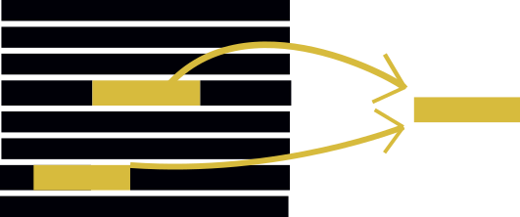
Machine Readable JATS
Where is the information I want (pull)?
(a few different places is OK)
What does this information contain?
Example: complete affiliations
How is this information formatted?

Slide 8
JATS XML-Through Workflows
Reduce publication times
Reduce introduction of errors
Save money
Greater focus on metadata
Better author/staff experience
More amenable to automated analysis
AI document analysis
QA with Schematron

Slide 9
Machine Writeable JATS
Where does this information go (push)?
(only one place, hopefully)
How does this information interact with the rest of the article?
How am I entering this information?
Solution: Subset the JATS DTD

Slide 10
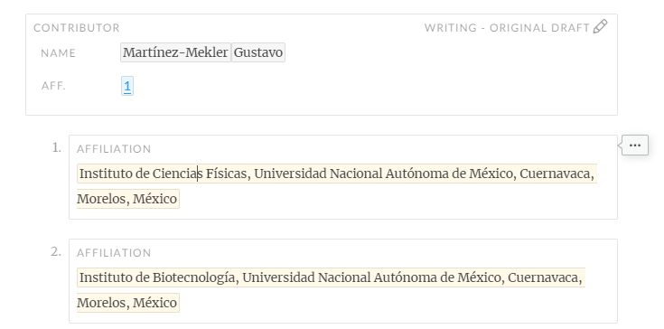
Subsetting Example 1: <aff>
Only allowed one place: within <contrib-group>
Must be associated to authors via an <xref> cross reference
No <label>

Slide 11
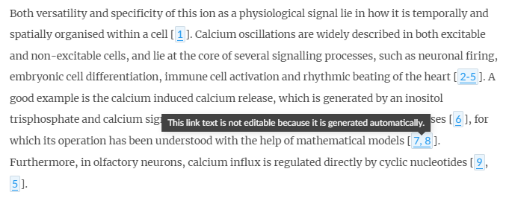
Subsetting Example 2: <ref>
No <label>
and um, uh

Slide 12
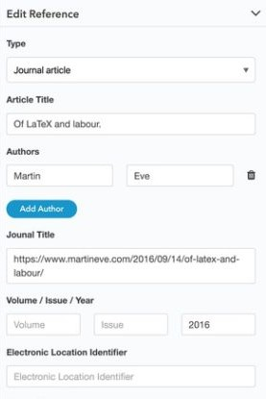
Subsetting Example 2: <ref>
Form-based?
Only <element-citation>
Contains reference elements only
No punctuation, spaces, or untagged text

Slide 13
Subsetting Example 2: <ref>
Text-entry based?
Only <mixed-citation>
Punctuation, spacing, and untagged text allowed

Slide 14
Solving Problems with Standards

Slide 15
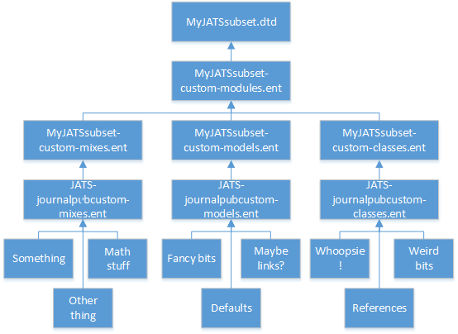
JATS is Made to Be Customized
JATS is modular
You don’t need to touch common files
Just override content models in your custom, high-level files

Slide 16
JATS Compatibility Meta-Model
https://groups.niso.org/apps/group_public/download.php/16764/JATS-Compatibility-Model-v0-7.pdf

Slide 17
oh, and also Schematron
Schematron is a rule-based validation language
You can validate content as well as structure
You can write you’re your own error messages
Not all of the restrictions that you want to enforce can be expressed via DTD

Slide 18
What Does Subsetting Get You?
Tools for creating and editing XML are easier to build, easier to maintain, and more robust
Predictable content for rendering and transforming
Clear expectations for suppliers and other partners
A handy means for enforcing these expectations

Slide 19
What to Avoid When Subsetting
Don’t get rid of things that are mandatory in the parent DTD
Your subset should be valid to the parent DTD
Don’t get rid of anything if it doesn’t get you a “win”
Me sowing . . .
Me reaping . . .
Don’t forget to document everything

