Slide 1
Statistics – COUNTER and Other Measures that Matter
Moderator:
Michael Habib, Clarivate
Speakers:
Athena Hoeppner, University of Central Florida
@athenahoeppner
Joe Wass, Crossref
@joewass
#NISOPlus20
24 February 2020. Baltimore, MD.
http://bit.ly/NISOPlus_Stats_Countr_MTM

Slide 2
COUNTER: Concepts, Overview, and Use Cases
Athena Hoeppner
University of Central Florida
athena@ucf.edu
@AthenaHoeppner
Discovery Services Librarian
User of stats
COUNTER Technical Advisor Group Member

Slide 3
Project COUNTER Structure
COUNTER is supervised by a Board of Directors and administered by an Executive Committee and Technical Advisory Group. The Executive Committee and Technical Advisory Group are all volunteers.
- Wikipedia https://en.wikipedia.org/wiki/Project_COUNTER#Structure

Slide 4
COUNTER Code of Practice (COP) is a set of technical specifications for platform vendors

Slide 5
Translates interactions with interfaces and content into consistently reported statistics. Does not interpret user intent.

Slide 6
User actions mapped to COUNTER 5 metrics (JSTOR)
JSTOR user action | Common page(s) | R5 metric
Download a PDF | Search results, full-text article, chapter, report page | Item_Requests
Download an image* | Image modal from search results | Item_Requests
View full-text article, chapter, report | Article page, chapter page, report page | Item_Requests
View image modal* | Search Results | Item_Investigations
Download book epub | Book TOC (when available) | Item_Requests (Book level)
View article, report page - no access | Unauthenticated access / abstract view of article page, report page | Item_Investigations, No_License
View book chapter - no access (redirect to TOC) | Unauthenticated access / abstract view attempt of book chapter | No_License, Item_Investigations
View book TOC - no access, (no redirect from chapter) | Unauthenticated access (not logged in)/ abstract view of book TOC | No_License, Item_Investigations
Basic Search | Home page, Topic page, Theme page, Global nav bar | Searches_Regular, Searches_Platform
Advanced Search | Advanced Search | Searches_Regular, Searches_Platform
Image Search | Image search (View more images) | Searches_Regular, Searches_Platform
Text Analyzer Search | Text Analyzer home | Searches_Regular, Searches_Platform
Data for Research Search | DfR create dataset search results | Searches_Regular, Searches_Platform
Federated search request (metasearch) | JSTOR XML Gateway | Searches_Federated
Notes:
From JSTOR Transparency into Metrics.

Slide 7
“Changes in the nature of online content and how it is accessed have resulted in the COUNTER Code of Practice evolving in an attempt to accommodate those changes.”
https://www.projectcounter.org/2448-2/

Slide 8
COUNTER Progressing with the Times
Pre-COUNTER:
not consistent, not comparable, not verifiably credible
Release 1 (2003):
basic search, session, turnaway, journal full text usage
Release 2 (2005):
platform-wide use (DR3), consortia reports
SUSHI (2006):
automate harvesting
Release 3 (2009):
federated/automated searches, book report, journal archive and YOP
Release 4 (2013): 24 Reports!
journal GOA, book chapter report, use per collection, mobile use, platform (PR1), multimedia reports,
Release 5 (2019): 4 Master Reports!
Revamp the Code of Practice!
New concepts, metrics, filters, and more!
Notes:
https://en.wikipedia.org/wiki/Project_COUNTER
R1: http://beta.projectcounter.org/r1/cv1.pdf
R2: http://beta.projectcounter.org/r2/COUNTER_COP_Release_2.pdf
R3: http://beta.projectcounter.org/r3/Release3D9.pdf
R4: https://www.projectcounter.org/code-of-practice-sections/usage-reports/

Slide 9
COUNTER Release 5: Four Master Reports
Database Master Report (DR)
Title Master Report (TR)
Item Master Report (IR)
Platform Master Report (PR)

Slide 10
COUNTER R5: Twelve Standard Reports
Database Master Report (DR)
DR_D1 Database Search and Item Usage
DR_D2 Database Access Denied
Title Master Report (TR)
TR_B1 Book Requests (Excluding OA_Gold)
TR_B2 Book Access Denied
TR_B3 Book Usage by Access Type
TR_J1 Journal Requests (Excluding OA_Gold)
TR_J2 Journal Access Denied
TR_J3 Journal Usage by Access Type
TR_J4 Request by YOP (Excluding OA_Gold)
Item Master Report (IR)
IR_A1 Journal Article Requests
IR_M1 Multimedia Item Requests
Platform Master Report (PR)
PR_P1 Platform Usage

Slide 11
Standard Reports
Looks Familiar!
PR_P1 Platform Usage
DR_D1 Database Search and Item Usage
DR_D2 Database Access Denied
TR_B1 Book Requests (Excluding OA_Gold)
TR_B2 Book Access Denied
TR_B3 Book Usage by Access Type
TR_J1 Journal Requests (Excluding OA_Gold)
TR_J2 Journal Access Denied
TR_J3 Journal Usage by Access Type
TR_J4 Journal Request by YOP (Excluding OA_Gold)
IR_A1 Journal Article Requests
IR_M1 Multimedia Item Requests
Sample COUNTER Master Reports and Standard Views https://www.projectcounter.org/appendix-i-sample-counter-repor/

Slide 12
COUNTER R5 Reports: New Metrics, Concepts, and Terminology

Slide 13
Attributes in R5 Reports: Lots of IDs and Titles
Item
Publisher
Publisher_ID
Platform
Authors
Publication_Date
Article_Version
DOI
Proprietary_ID
ISBN
Print_ISSN
Online_ISSN
URI
Parent_Title
Parent_Data_Type
Parent_DOI
Parent_Proprietary_ID
Parent_ISBN
Parent_Print_ISSN
Parent_Online_ISSN
Parent_URI
Component_Title
Component_Data_Type
Component_DOI
Component_Proprietary_ID
Component_ISBN
Component_Print_ISSN
Component_Online_ISSN
Component_URI
Data_Type
Section_Type
YOP
Access_Type
Access_Method
Metric_Type
Reporting_ Period_Total
Monthly_Usage_Details

Slide 14
Attributes in R5 Reports: Elements that Illuminate
Item
Publisher
Publisher_ID
Platform
Authors
Publication_Date
Article_Version
DOI
Proprietary_ID
ISBN
Print_ISSN
Online_ISSN
URI
Parent_Title
Parent_Data_Type
Parent_DOI
Parent_Proprietary_ID
Parent_ISBN
Parent_Print_ISSN
Parent_Online_ISSN
Parent_URI
Component_Title
Component_Data_Type
Component_DOI
Component_Proprietary_ID
Component_ISBN
Component_Print_ISSN
Component_Online_ISSN
Component_URI
Data_Type
Section_Type
YOP
Access_Type
Access_Method
Metric_Type
Reporting_ Period_Total
Monthly_Usage_Details

Slide 15
Data_Type
Data_Type Values
Article
Book
Book Segment
Database
Dataset
Journal
Multimedia
Newspaper_Or_Newsletter
Other
Platform
Report
Repository Item
Thesis_Or_Dissertation
The field identifying type of content.
Database Master Report (DR)
✓
Title Master Report (TR)
✓
Item Master Report (IR)
✓
Platform Master Report (PR)
✓

Slide 16
Section_Type
The attribute that identifies the type of section that was accessed by the user.
Section_Type Values
Article
Book
Chapter
Database Master Report (DR)
Title Master Report (TR)
✓
Item Master Report (IR)
✓
Platform Master Report (PR)

Slide 17
Access_Type
Indicates whether usage activity required authorization.
Access_Type Values
Controlled
OA_Gold_APC
OA_Gold_Non_APC
OA_Delayed
Other_Free_to_Read
Controlled: Any access that required a registration, login, subscription, payment, etc. OA content behind any login is considered Controlled access.
Database Master Report (DR)
Title Master Report (TR)
✓
Item Master Report (IR)
✓
Platform Master Report (PR)

Slide 18
Access_Method
Indicates if usage generated by browsing and searching or by any Text and Data Mining.
Access_Method Values
Regular
TDM
Database Master Report (DR)
✓
Title Master Report (TR)
✓
Item Master Report (IR)
✓
Platform Master Report (PR)
✓

Slide 19
Metric_Type
Metric_Type Values
Total_Item_Investigations
Unique_Item_Investigations
Unique_Title_Investigations
Total_Item_Requests
Unique_Item_Requests
Unique_Title_Requests
Searches_Regular
Searches_Automated
Searches_Federated
Searches_Platform
Limit_Exceeded
No_License
Identifies the nature of the usage activity.
Database Master Report (DR)
✓
Title Master Report (TR)
✓
Item Master Report (IR)
✓
Platform Master Report (PR)
✓

Slide 20
Investigations v Requests
Investigations = All interactions, including Requests are
Requests = Access of the full content of an item

Slide 21
Total v Unique
Some Journal Article Record
Total counts each interaction per title or item during a session
4 total Investigations
3 clicks
1 auto load
Unique counts one interaction per title or item per session
1 unique item Request
1 unique item Investigation
click
auto-load
click
click

Slide 22
Requesting Reports via Forms: Atypon Example

Slide 23
Filter for a Multitude of Custom Reports
Flexible report request forms
Filter select:
Reporting Period
Content/Data types
Metric/Use types
Year of Pub
License types
and more in various combos

Slide 24
SUSHI: Auto Harvesting
Updated to match R5
RESTFUL instead of SOAP requests
Returns results in JSON format
Can use APIs to pull data for subset of usage, i.e. for a single journal by ISSN
SUSHI Harvesters not yet ready in many tools

Slide 25
SUSHI Call URLs
https://{domain.from.vendor.com}/ reports/{report_type in lower case}?
requestor_id={id provided to you by vendor}
&customer_id={id also provided by vendor}
&begin_date={yyyy-mm-dd or yyyy-mm}
&end_date={yyyy-mm-dd or yyyy-mm}
&other parameters for the master reports
Instructions:
Wiley: https://onlinelibrary.wiley.com/pb-assets/Lib%20Marketing/Usage%20Statistics%20on%20WOL%20-%20FAQ.pdf
JSTOR: https://support.jstor.org/hc/en-us/articles/360015483214-SUSHI-reports-COUNTER-5-overview
EBSCO: https://sushi.ebscohost.com/R5/swagger-ui.html#/reports45controller

Slide 26
Use Cases: Simple(ish)
See Usage Trends and Comparisons
Compare current year with previous year
Compare use between institutions
Compare same use type between vendors
Sum total use per metric across all vendors

Slide 27
Use Cases: Common
Usage Assessment and Renewal Decissions
Cost per use
Invoices or Pricing spreadsheet + DR or TR
Titles with zero use
KBART holdings + TR

Slide 28
Use Cases: Pivot Tables
Reveal use patterns per Subject, Fund Code, Purchase type, Publication year, etc.
TR + Vendor or Agent title reports
Pivot Table to Analyze by:
Metric_Type
Data_Type
Section_Type
Access_Type
YOP
COUNTER Foundation Class 10: Working with COUNTER 5 reports in Microsoft Excel https://www.youtube.com/watch?v=AU_DBLi4hSo

Slide 29
Step One: Get Data
Step Two: Find a Match Point
Step Three: Mash the Data Together
Step Four: Filter, Pivot, Sum, and Play!

Slide 30
Data Sources
COUNTER Reports
Institutional KBART
Integrated Library System
Subscription and Purchase Agents
Vendor Dashboards and Admin

Slide 31
Matching Data
Potential Match Points
Proprietary IDs
ISBN (print maybe best)
Titles
Other IDs

Slide 32
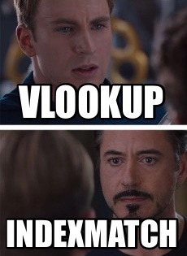
Merging Data Sources
Pull the needed elements into one table.
VLOOKUP
SUMIFS
COUNTIFS
Name Ranges
INDEX MATCH?

Slide 33
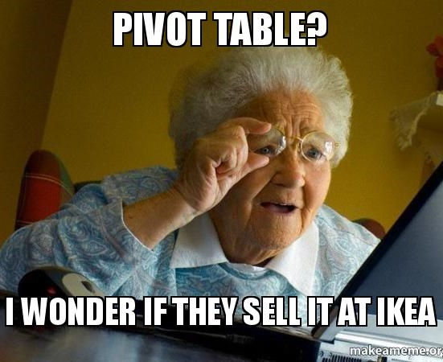
Analyze and Explore
Filters
Pivot Table Slicers
Create charts
Look for values:
Familiar to people
Outliers
Relevant

Slide 34
Use Cases: Impossible
Use per User Type (i.e. Faculty, Student)
No way to align COUNTER with user data
Complete Use of OA per Institution
Unauthenticated accesses can’t be attributed to an institution
Conversion of Investigation on One Platform into Request on Another
User path into and out of the platform is not tracked

Slide 35
Some Problems Won’t Go Away
ISSN, DOI, other IDs not universally applied
Title variations
Single line invoices
Different platforms result in different usage patterns
OA use may be invisible
COUNTER does to reveal UX, user intent, user engagement, content value, or impact.

Slide 36
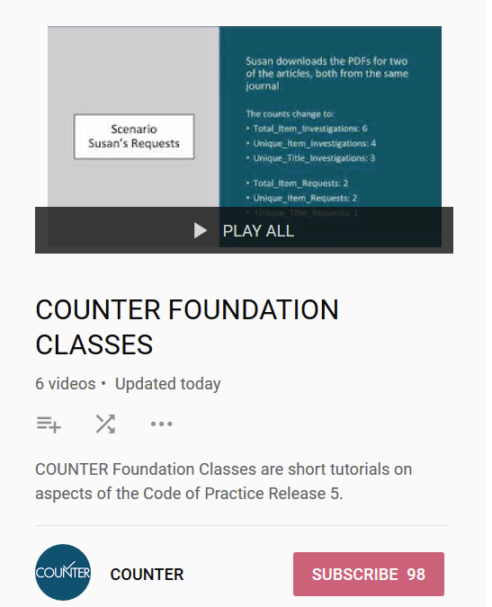
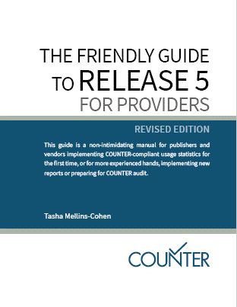
Learn More
Friendly Guide to Release 5 for Librarians
https://www.projectcounter.org/friendly-guide-release-5-librarians/
Friendly Guide to Release 5 for Providers
https://www.projectcounter.org/wp-content/uploads/2019/05/Release_5_Providers_20190509-Revised.pdf
COUNTER Foundation Classes
https://www.youtube.com/playlist?list=PL9OAw4zLhfa0bzMLXAfJXGhlbGjG8y_fg

Slide 37
Thank you!
Athena Hoeppner
@athenahoeppner

