Slide 1
Going from Here to There: NISO Content Platform Migrations Working Group
Kim Steinle, Library Relations and Sales Manager, Duke University Press
Athena Hoeppner, Discovery Systems Librarian, University of Central Florida
#NISOplus @ksteinle @athenhoeppner
24 February 2020
Baltimore, MD
Notes:
KS

Slide 2
How the CPM Came To Be
NISO Information Policy and Analysis TC sought ideas for new working groups
Kim and Athena members of IPA
Duke U Press migrated platforms in Nov. 2017
Shared experience across stakeholder groups
Notes:
KS
NISO IPA Topic Commitee
migrations can be challenging and not enough communication between parties - everyone could agree so good opp to work together
it seems everyone has been through a migration and has a story or two, so it was natural for folks to sign on - we received a lot offers of help, which was really encouraging

Slide 3
So Many Migrations
Publishers:
1 every 5-10 years
Content Platform Vendors:
5-10 per year
Librarians:
10+ per year and growing
(librarians reported over 30 content platforms migrated from 2016 to 2019.)
Notes:
Athena
Publishers don’t do migrations often
Librarians are subjected to lots of migrations but have little control over how they are run
Content Platform vendors do them regularly and are focused on helping their publishers but don’t always have a good view into the librarian’s experience

Slide 4
Finding Participants
Notes:
KS - how we found people, what was the rationale of getting these people - having platform vendors included is unique
We looked for people who had experience with migrations from across the industry. We especially wanted to include content platform vendors, since there isn’t usually a direct connection between them and librarians. Since we wanted to not make the group too large, we also consult with others, esp other vendors who might have some part in migrations, to make sure they aren’t left out (thinking Shibboleth, Open Athens, discovery vendors, etc)
Shout out to Nettie, who keeps it all together and keeps us moving!

Slide 5
The Work Item
Develop a recommended practice to help with standardizing processes and provide recommendations to all parties, to improve communications before, during and after migrations.
Notes:
Athena
As Kim mentioned, the group’s participants are all stakeholders and experts in the work that happens before, during, and after a platform migration.
Under the guidance of Nettie Lagace (NISO) and co-chairs Kim Steinle (Duke University Press) and Athena Hoeppner (University of Central Florida), the combined expertise of group members allowed us to come up with an overall work concept.
That concept is to develop a recommended practice to help with standardizing processes and provide recommendations to all parties, to improve communications before, during and after platform migrations.
Platform migrations have become more frequent and more complex in our current scholarly landscape; we’ve all seen examples of migrations that have gone well and that have gone poorly.
Using these experiences, our group aims to provide more clarity and transparency to the processes and technical standards involved in a platform migration while also providing guidance on communication across all relevant stakeholders.
Group members agreed early on that communication, or lack thereof, was a key factor in the success or failure of a platform migration; communication has been the subject of intense focus and discussion in our work so far.

Slide 6
Planned Deliverables
Recommendations for publishers and vendors to ensure migration addresses librarians’ and end users’ needs
Communication plan
Checklists for publishers, vendors and librarians
Glossary of key terms
Notes:
Athena
Like other recommended practices or standards, our planned deliverables are fairly straightforward:
We aim to provide recommendations for all stakeholders to ensure a smooth migration and address librarian and end user needs.
To support our recommendations, we want to create a framework for a communication plan to be used by publishers and platform vendors.
We will be distilling our recommendations into checklists for major stakeholders, including publishers, platform vendors, and librarians to provide an equitable starting point for all parties.
And we will provide a glossary of key terms where we will spell out acronyms, define terminology, and link to key industry standards and processes.

Slide 7
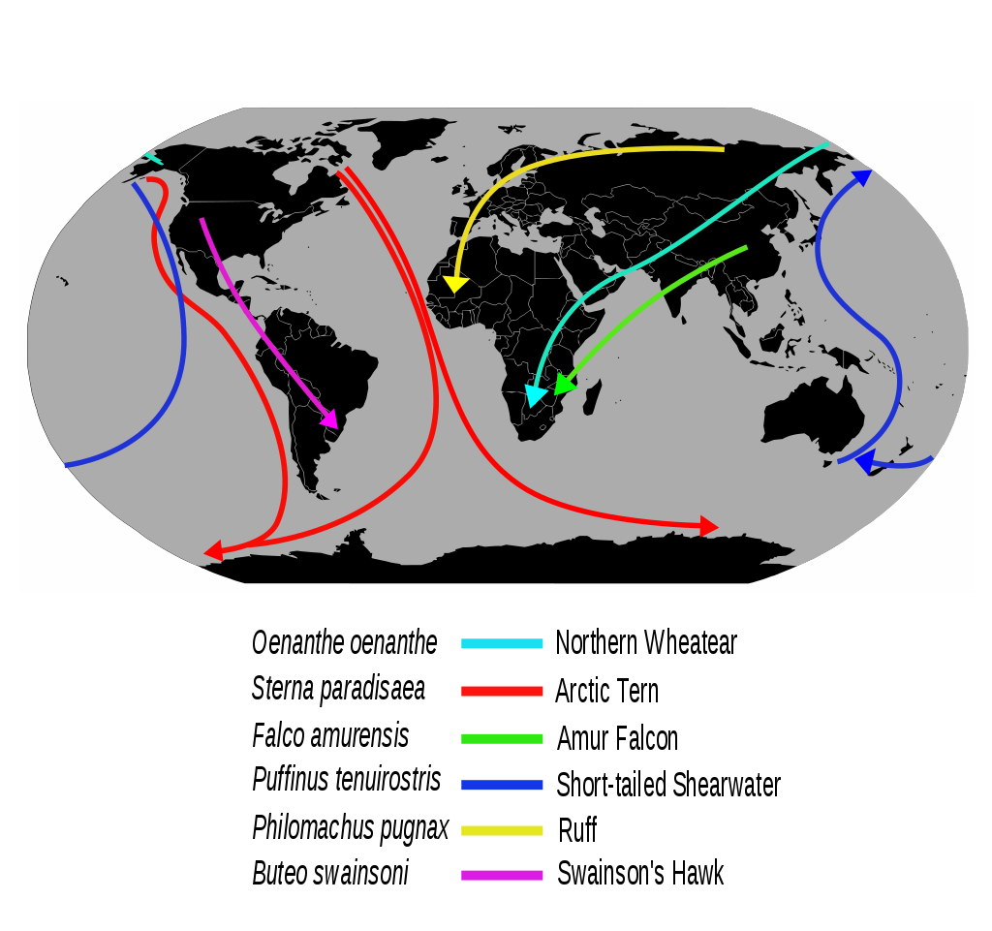
The Process: State of Migrations
Investigate the state of migrations
Interviews / Surveys / Literature review
Vendor communications and checklists
Timelines / Cycles / Decisions
Notes:
Kim
The group explored several topics, concepts, and state of affairs by conducting interviews, surveys, and literature review. We investigated the overall state of migrations, current practices and issues for each stakeholder group, and potential improvements and solutions.
We have contacted librarians and consortia, platform vendors, content vendors, and other stakeholders in the information supply chain.
Some areas of investigation:
1. Vendor-provided communications and checklists from previous migrations
2. Vendor internal timelines, cycles, and decisions, and the questions, and pain points for platforms/content providers
3. The experience of Libraries, Consortia, and Librarians during migrations, points of confusion, and typical action items.
4. Technical and communication needs for specific groups and technologies impacted by migrations, such as discovery and knowledge base technologies, authentication technologies, etc.

Slide 8
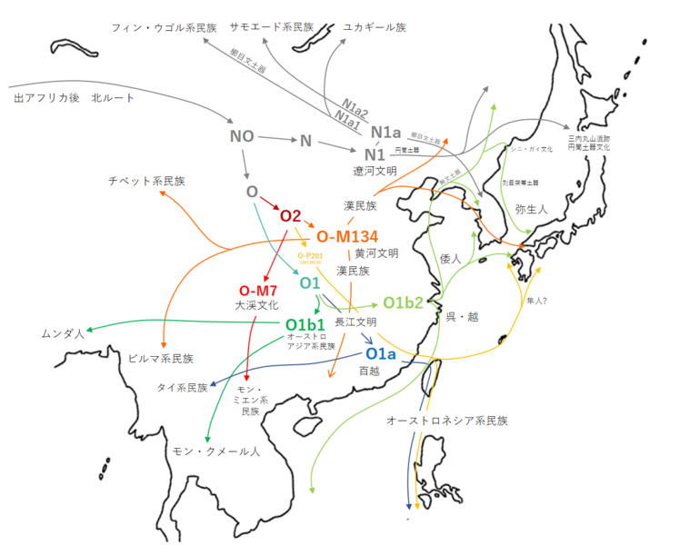
The Process: Related Standards
Review related standards and organizations
TRANSFER Code of Practice
KBART/KBART Automation
DOI/Crossref
Authentication
Usage (COUNTER & SUSHI)
Notes:
Athena
The working group identified a variety of standards and organizations that were integral or related to the platform migration process. While we don’t have time to talk about all of them today, we want to highlight a few that were discussed in depth:
The Transfer code of practice is a NISO recommended practice that provides guidelines for journals that are moving from one publisher to another. Transfer’s committee has often been given feedback asking if platform migrations can be addressed by the Transfer Code. We were never able to integrate platform migrations into the code but we think that some of Transfer’s guiding principles can be adapted for the platform migration guidelines we’re working on now:
"promote a set of standards that apply whenever electronic content is migrated from one platform to another and to encourage the industry to embrace these standards as a baseline level of quality and performance"
“the Code does not supplant contractual terms, intellectual property rights, or the competitive marketplace between publishers. In all [platform migrations], contract terms negotiated between the parties involved in the transfer will govern.”
Ensuring that all content is migrated or retired - supplemental digital content like AV content, apps, etc. as well as, e-alert registrants and that relevant stakeholders are informed of the planned changes.
KBART & Automation: provides best practices for the communication of electronic resource (both serials and monographs) information from content providers to knowledgebase developers to help ensure data integrity in the knowledgebase.
Knowledgebases provide metadata to support various library discovery services including OpenURL link resolver, library catalog, and a variety of ERM tools. During a platform migration, e-resource URLs often change and sometimes the content structure changes. Such change needs to be updated accurately and promptly in the knowledgebase to ensure accurate linking to the affected electronic resources with minimal interruption to library patrons. KBART and automated KBART can provide crucial and current data for library specific holdings during a platform migration.
DOI/Crossref: Crossref assigns and maintains digital object identifiers (DOI’s) that provide a mapping between a unique fixed id for scholarly content and the current location of that content on the web. This enables a more seamless location and citation of scholarly content on the web but it also means that managing the process of updating the Crossref database during a platform migration is critically important.
During a migration, a list of DOI’s and the new metadata and links is generated. Ahead of launch, Crossref is notified that a change is coming on a specific date. The platform vendor, on the day of launch, redeposits all of the DOI’s, metadata and URLs with the new platform information.
Authentication: another pain point during a platform migration is ensuring that authentication mechanisms are migrated for each customer. The authentication landscape across users of e-resource content is complex; the work of making authentication seamless during a migration spans multiple authentication types, including user names and passwords, IP addresses, SAML-based systems, and remote access options such as EZProxy.
Usage (COUNTER & SUSHI): COUNTER reports and the SUSHI protocol allow libraries to collect usage data that is critical for libraries perform collection assessment and cost per user (CPU) calculations, allowing for collection decisions.
Migration challenges include setting up COUNTER and SUSHI reporting on the new platform and ensuring that reports are accurately representing usage for customers as well as the transfer of historical usage data from one platform to another. Additionally, some vendors open up access across all their subscription content after a migration, which can lead to inflated or skewed usage statistics for institutions who only subscribe to a subset of the vendor’s content.

Slide 9
The Process: Stakeholders
Information gathering - stakeholder perspectives and experiences
Publishers
Content platform providers
Libraries
Other technology providers
Notes:
Athena
Libraries Typical action items
Sign up for publisher email alerts; review migration website (if available).
Confirm entitlements.
Prepare for link resolver, URL, discovery layer, and ERM changes.
Gather usage statistics from old site.
Verify you have access - including access to purchased entitlements after grace period.
Update IP address and/or remote authentication configurations.
Publishers (we looked to those who had been through migrations and gathered materials, data and feedback from those experiences)
Craft your communication plan - who, when, where
Gather appropriate contacts
Create website for migration information
Determine hard cutover or simultaneous hosting
Determine launch date
Determine if URLs will change
Publish URL crosswalk if updating links
Determine if usage from old platform will be made available - how much and where
If usage should be pulled before migration, communicate this to librarians
Content platform providers
Facilitate dissemination of communication plan to subscribers
Generate a crosswalk document if necessary
DOI update at Crossref - at launch date
Continue to host usage statistics for two years after migration
Other technology providers - authentication, knowledgebase providers, discovery providers
Technical and communication needs -

Slide 10
Migration from Publisher Perspective
Build stakeholder consensus on platform requirements
Communicate with ALL interested parties
Migrate without loss of customer data or access
Schedule migration phases and manage schedule changes
Update URLs and create redirects:
DOI resolution, OpenURL link resolvers
Update and circulate metadata
MARC records, Discovery services and A&I
Plan for when something goes wrong (it will)
Image source: creative commons licensed (BY-NC-ND) flickr photo by GRID Arendal: https://https://www.flickr.com/photos/gridarendal/31379908630
Notes:
KS Publishers have to look in two directions – communication and understanding of project plan with Vendor and communication with library customers
1. Lack of effective communication (being specific, speed, quality). Publishers and vendors speak very difference language so it's important that the publisher understands how and what to communicate, in vendor-speak. 2. Never assume! Do not even the most basic of tasks such as 'the vendor will deposit our DOIs because the last vendor did'. 3. Lack of knowledge at publisher resulting in new vendor not understanding what was needed. 4. Lack of time! Lack of time for set up, lack of time for QA. 5. As a publisher, not being able to determine what is highest priority.

Slide 11
Migration from Platform Vendor Perspective
What format is your content in?
Here’s the archive!
Where’s the account information? User profile information?
To overlap or not.
The myth of the instantaneous cutover.
Redirects are your friend.
The appearance of U.S. Department of Defense (DoD) visual information does not imply or constitute DoD endorsement. / https://www.dimoc.mil/resources/limitations/
Notes:
KS
Platform vendors have to contend with whatever format the publisher (or the previous vendor) can provide – can vary, with front and back content being wildly different
Sometimes the user profile info can’t move over
Deciding on overlap or hard cutover is an important decision
But remember, even if you choose hard cutover it won’t be instant – new links need to propagate – can vary based on global location
Please redirect, but remember that you won’t want to rely on these forever

Slide 12
Migrations from Librarian Perspective
Actionable communication
Need timeline
Metadata updates and MARC reloads
Endangered entitlements
URL crosswalks and permanent redirects
Authentication and access
Coordination with key third-party vendors (discovery services, knowledgebase, and link resolver providers)
The appearance of U.S. Department of Defense (DoD) visual information does not imply or constitute DoD endorsement. / https://www.dimoc.mil/resources/limitations/
Notes:
Athena
Lack of communication (emails versus websites versus nothing; not detailed enough, not timely, and/or directed to the wrong person/department).
Timeline - start of semester versus summer; two weeks versus six months.
Disappearing entitlements not carrying over (access discrepancies between old and new platforms).
Metadata updates: URLs break, re-directs don’t work as expected, and sometimes DOIs don’t get updated; MARC records not updated.
Authentication problems: customer IP addresses or user names and passwords don’t migrate correctly to the new platform; proxy - new platform not tested before release.
Lack of coordination with key third party vendors (discovery services, knowledgebase, and link resolver providers)
Changes not being submitted to discovery and knowledgebase vendors; sometimes discovery indexes, A-Z lists and link resolvers aren’t updated until well after the migration has occurred.

Slide 13
Other Stakeholders
Authors, Editors, Content Creators
CrossRef
Google Scholar
Knowledgebase and Link Resolvers
Discovery and A&I vendors
Archive Solutions (i.e. CLOCKSS, Portico)
Plagiarism services
Any service that needs to link to, receive content from, or interact with the new platform
The appearance of U.S. Department of Defense (DoD) visual information does not imply or constitute DoD endorsement. / https://www.dimoc.mil/resources/limitations/
Notes:
AH

Slide 14
Planned Deliverables
Recommendations for publishers and vendors to ensure migration addresses librarians’ and end users’ needs
Communication plan
Checklists for publishers, vendors and librarians
Glossary of key terms
Notes:
Athena
Like other recommended practices or standards, our planned deliverables are fairly straightforward:
We aim to provide recommendations for all stakeholders to ensure a smooth migration and address librarian and end user needs.
To support our recommendations, we want to create a framework for a communication plan to be used by publishers and platform vendors.
We will be distilling our recommendations into checklists for major stakeholders, including publishers, platform vendors, and librarians to provide an equitable starting point for all parties.
And we will provide a glossary of key terms where we will spell out acronyms, define terminology, and link to key industry standards and processes.

Slide 15
Timeline
Notes:
KS

Slide 16
Questions?
Image source: creative commons licensed (BY-NC-ND) flickr photo by Tarnya Hall: https://www.flickr.com/photos/farflungphotos/2531438211

