Slide 1
Introduction to
Seamless Access
Delivering a simpler, privacy-
preserving access experience

Slide 2
For the next 45 mins ...
Why SeamlessAccess?
How does it work?
What’s the current status?
How do I participate?
#SeamlessAccess
Notes:
For the next 45 mins I’m going to provide a general introduction to the SA initiative. There’s a lot to cover, so we’ve left plenty of time for questions in the follow-on ‘conversation’ session at 10am.
My talk will cover 4 areas:
First I’ll briefly recap why we’re here i.e. why was SA created and the history of this initiative to date
Then I’ll get a little more technical and walk through how federated authentication and SA work, so you’re familiar with some of the technical terms and we can build on that knowledge when we talk about privacy and security.
Third, I’ll give a status update so you’re all caught up
And, last, I’ll talk about how you can participate to deliver more seamless access to your users

Slide 3
Why are we here?

Slide 4
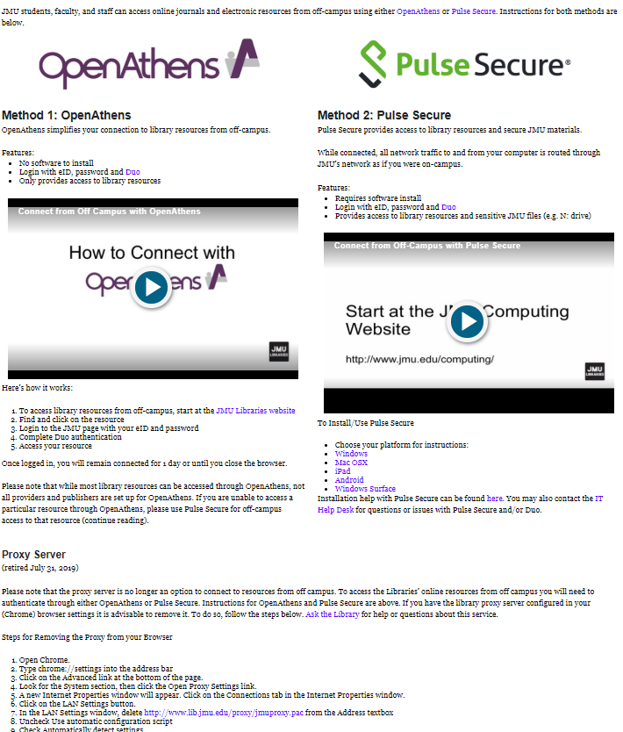
Why Are We Here?
Improve remote access scenarios
Improve usability via a secure, single sign-on solution
Personalized user services capabilities
Enhance user privacy mechanisms
#SeamlessAccess
Notes:
Why in the world do we even need this? Isn’t this a solution looking for a problem? Proxy solutions like EZproxy only cost libraries $500 a year and work just fine.
Library use of IP recognition was developed when off-site access to electronic resources was in its infancy and has changed very little since then. EZproxy was a godsend at a time when it was difficult and unwieldy to get a proxy server setup and then support users trying to make configuration changes to their browser, and then needing to remember to undo these. But, after 20 years of IP authentication, there are better alternatives.
SeamlessAccess has a number of important goals:
Improve remote access scenarios
There’s been a considerable increase in remote access to online resources over the years - from a multitude of devices.
With IP authentication we force researchers to start from, or at some point circle back through, the library’s web site to find a proxy-prefixed URL, extra friction that simply deters users. This isn’t how researchers research. We should aim for delivery at the point of discovery.
Improve the usability of access workflows. Current issues include:
Numerous clicks to get to content behind an authentication barrier
Numerous user credentials scattered over a multitude of platforms; libraries have not kept pace with the consumer web.
If an institution is using VPN, Shibboleth, and EZproxy, the user is immediately overwhelmed (see image)
Access is currently so complicated that fully-entitled end-users are turning to alternative resources, such as SciHub, ResearchGate, etc..
3. Personalize user services capabilities (more later)
4. Enhance user privacy mechanisms (more on that later, too.)

Slide 5
Security Concerns / Workflow Issues
IP Authentication is less secure than federated authentication
URL rewriting vulnerabilities
One compromised user = blocked access for institution
Widespread issues with admin of library IP addresses
#SeamlessAccess
Notes:
There are also some important security concerns and workflow issues with traditional IP authentication:
The perceived wisdom is that IP authentication is more privacy-preserving than federated authentication. It’s not. IP addresses can directly identify individuals with a dedicated IP address (GDPR considers IP addresses as Personal Data in some circumstances), and an inadvertent side effect is that users can be forced to pass over individual credentials in order to benefit from personalization (personal data that, all too often, can compromize their privacy and security).
Most libraries still use some type of URL rewriting methods (EZproxy, WAM) which have security vulnerabilities, such as:
IP Spoofing / Man-in-middle attacks - especially over wireless networks
Clickjacking - user credentials are sometimes prompted within an iframe - easy to exploit
Session hijacking - session cookies are sometimes sent in the clear
Blocking IP addresses is a blunt tool: if a vendor identifies one compromised user account, access is cut off for the entire institution - instead of for one compromised or malicious user account
IP addresses themselves are subject to change (sometimes without the knowledge of the library), often stored in a variety of formats, and pass through many hands between IT, the library, and service providers. “On average, 58% of the IP ranges held by publishers to authenticate libraries who license their content are inaccurate” (Publishers Solutions International, 2017)
You’ll find similar concerns expressed by groups like FIM4L (Federated Identity Management for Libraries), a library-led working group looking to improve access scenarios via federated authentication.

Slide 6
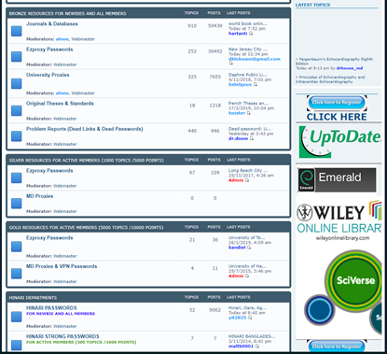
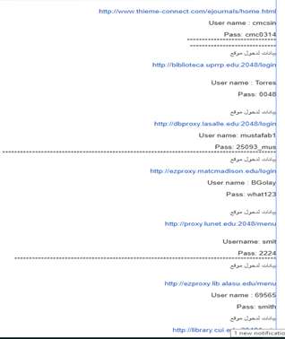
Compromised User Credentials
#SeamlessAccess
Notes:
Another major concern is the volume of compromised user credentials available on the web, typically including a link to the list of library resources that can be accessed using them. The examples on this slide took about 5mins to find:
Image on left is a web board
Image on right is from a personal Google Drive document
While compromised credentials impact both IP authentication and Federated authentication, the big difference is that you can far more easily identify and shut down access to compromised credentials with Single Sign-On. In contrast, it can take days of painstaking analysis through logs to trace the access back from an IP address through the proxy server to a physical computer, and then back to a specific login.

Slide 7
Who can benefit?
Library patrons
Research collaborations
Institutional workflows
#SeamlessAccess
Notes:
Access issues are often presented in the context of patrons accessing library resources. While that’s an important use case impacting millions of users across the world, the benefits of SA are much wider. For example:
1. Research collaborations
A common feature of research is the need to collaborate with colleagues in the field at other institutions - for example, to share research and datasets. Unlike most library access, research collaborations involve sharing much more detailed information, such as a user’s name, email address, role and department. The authentication challenges faced by researchers collaborating across institutions has long been recognized.
2. Institutional workflows
Another area where SA can help is in institutional workflows that require users to confirm their institutional affiliation with 3rd parties. A good example is the growing need to authorize the use of institutional funds for open access publishing fees, such as Article Processing Charges.
Notes:
AACR (Authentication and Authorisation for Research and Collaboration), an initiative launched in May 2015 to address the increased need for federated access and for authentication and authorisation mechanisms by research and e-infrastructures); and
FIM4R (Federated Identity Management for Research), a collection of research communities and infrastructures with a shared interest in enabling Federated Identity Management for their research cyber infrastructures - ranging from the arts & humanities (DARIAH) through to photon & neutron science (Umbrella)

Slide 8
The recap ...
Resource Access in the 21st Century project (RA21) initiated in 2016
Stakeholders from the publishing, library, software, and identity communities; input from 60 organizations.
Identified that Federated Authentication held the most promise for providing a robust, scalable solution for remote access to scholarly content.
#SeamlessAccess
Notes:
Ok, so we’ve reviewed why SA is a valuable initiative and who can benefit. Let’s now briefly recap the work that’s been done to date, starting with the the Resource Access in the 21st Century project (or RA21) that was initiated in 2016, initially to explore the challenge of remote access.
It involved stakeholders from the publishing, library, software, and identity communities; and took input from 60 organizations over 3 years.
It identified that Federated Authentication held the most promise for providing a robust, scalable solution for remote access to scholarly content.
It also investigated barriers to take-up, developed best practices, and piloted technical approaches to simplifying access.

Slide 9
The recap ...
Conclusions published as a draft NISO Recommended Practice in April 2019
>200 comments helped identify further areas for investigation and confirm the value of testing a beta service
Final NISO Recommended Practice* published in June 2019.
* Recommended Practices for Improved Access to Institutionally-Provided Information Resources: Results from the Resource Access in the 21st Century (RA21) Project
#SeamlessAccess
Notes:
RA21’s conclusions were published as a draft NISO Recommended Practice last April, receiving >200 comments that helped identify further areas for investigation and confirmed the value of testing a beta service.
A final NISO Recommended Practice was published in June 2019, and is available at the NISO website with the brevity-challenging name of “Recommended Practices for Improved Access to Institutionally-Provided Information Resources: Results from the Resource Access in the 21st Century (RA21) Project”

Slide 10
What is SeamlessAccess?
Community-driven effort to enable seamless access
5 founding organizations (to date):
The operational successor to the RA21 project
Deliverables: an operational service + best practices / standards
#SeamlessAccess
Notes:
SA was created in July 2019 as a community-driven effort to enable seamless access to information resources, scholarly collaboration tools, and shared research infrastructure.
To date, we have 5 founding organizations:
the National Information Standards Organization (NISO); organizers of this conference
GÉANT: a European Research & Education network that operates a service called eduGAIN that connects >60 R&E identity federations around the world. GÉANT also support related initiatives, such as FIM4L
Internet2: a US Research & Education network that operates the US identity federation, InCommon, among many other activities
ORCID: a non-profit that provides researchers with a digital, persistent identifier; and
the International Association of STM Publishers.
We’re actively seeking a partner to represent the library community.
Think of us as the operational successor to the RA21 project, delivering an operational service + best practices / standards

Slide 11
Who are SeamlessAccess?
A full-time implementation team
Governance and Advisory committees with representatives from across the stakeholder groups
An outreach committee
Two cross-industry working groups
#SeamlessAccess
Notes:
Next, who are we?
We have a full-time implementation team including an experienced librarian technologist, dedicated to library outreach
There are governance and advisory committees with representatives from across the stakeholder groups
There’s an outreach committee including 6 institutional participants.
And 2 cross-industry working groups that I’ll come back to later.

Slide 12
When is SeamlessAccess?
Piloting phase RA21
SeamlessAccess Beta Phase Operational
Full service operational
July 2019 – June 2020
July 2020 - onwards
December 2016 – June 2019
#SeamlessAccess
Notes:
And here’s an overarching timeline for our activities to date and going forward.
As I mentioned, the RA21 project developed and piloted ideas from the end of 2016 until last June, when it wrapped up. SA is now in the process of testing these ideas in the light of community feedback and developing best practices around the use of federated authentication. This beta phase is scheduled to run until June 2020. From July 2020, our goal is to have the service fully operational.

Slide 13
2. How does it work?
Notes:
Ok, so now let’s dive a little deeper into how this all works.

Slide 14
A brief refresher on Federated Authentication
Bob
Amy
#SeamlessAccess
Notes:
While IP authentication is an easy concept to grasp, Federated Authentication is more complex and much less well understood. It’s laden with jargon and acronyms that obscure a series of transactions that really aren’t complex to grasp at a basic level.
If you’re unfamiliar with the term Federated Authentication, you may recognize the name Shibboleth instead - Shibboleth is an open source software commonly used to implement Federated Authentication.

Slide 15
I’d like a book please
Bob’s Book Booth
Amy
#SeamlessAccess
Notes:
Let’s start with a simple analogy:
Bob runs a conference booth that provides books to anyone who studies at a subscribing institution. Amy comes up to the booth and says "Hi, can I have a book?"

Slide 16
Sure! Are you from a subscribing institution?
Bob’s Book Booth
Amy
#SeamlessAccess
Notes:
Bob says, "Sure” and asks her if she’s at a subscribing institution

Slide 17
Yes, I’m a student at
ABC College
Bob’s Book Booth
Amy
#SeamlessAccess
Notes:
Amy says that she’s a student at ABC College

Slide 18
ABC College:
Call Carol at XXXXX
Bob’s Book Booth
Amy
#SeamlessAccess
Notes:
However, Bob doesn’t know Amy so he needs to verify that she’s registered with ABC College.
Luckily, he has a phone book where he can look up someone who can help him. In the case of ABC College, the person to talk to is Carol.

Slide 19
Bob: Is this a student from
ABC College?
Carol
Bob’s Book Booth
Amy
#SeamlessAccess
Notes:
Bob calls Carol to ask if she can confirm that the person at his booth is a student at ABC College

Slide 20
Carol: Please pass the phone to Amy
Carol
Bob’s Book Booth
Amy
#SeamlessAccess
Notes:
Carol asks him to pass the phone to the student so she can talk to her directly

Slide 21
Carol confirms Amy’s identity with her
Carol
Bob’s Book Booth
Amy
#SeamlessAccess
Notes:
Carol talks to Amy and is able to confirm that she’s a valid student

Slide 22
Carol: I can confirm she’s one of our students
Carol
Bob’s Book Booth
Amy
#SeamlessAccess
Notes:
Amy passes the phone back to Bob so that Carol can confirm to him that she’s a student at ABC College

Slide 23
Bob: Can you confirm her name?
Carol
Bob’s Book Booth
Amy
#SeamlessAccess
Notes:
Now, Bob would ideally like to know the student’s name so that he can learn more about her interests and recommend other books to her in future

Slide 24
Carol: Sorry, that’s not our policy
Carol
Bob’s Book Booth
Amy
#SeamlessAccess
Notes:
However, ABC College’s policy is not to release student names and so Carol can’t provide Bob with any additional information on the student.

Slide 25
Bob: No problem, thanks Carol!
Carol
Bob’s Book Booth
Amy
#SeamlessAccess
Notes:
Bob has now verified that the student in front of him is at ABC College

Slide 26
Here’s a badge so other booths don’t need to ask the name of your college
Bob’s Book Booth
Amy
#SeamlessAccess
Notes:
Bob gives Amy her book, and also gives her a bright green badge to wear that says "I'm with ABC College" - Bob tells her that if the other booths see that badge, it'll save some time as she won't need to tell every booth which institution she studies at.

Slide 27
Carol
Bob
Amy
#SeamlessAccess
Notes:
This simple scenario is actually very close to how Federated Authentication works!

Slide 28
Service
Provider
Carol
Bob
Amy
#SeamlessAccess
Notes:
Bob is the 'service provider’ or SP that needs to check a visitor’s institutional affiliation before providing access to services.

Slide 29
Service
Provider
Carol
InCommon
UK Access Mgt Federation
Federation
Bob
Amy
#SeamlessAccess
Notes:
His phone book is a federation - a trusted list that details how to talk to a set of vetted institutions and vendors. Examples of federations include InCommon in the United States, and the UK Access Management Federation.

Slide 30
Service
Provider
Identity
Provider
Carol
InCommon
UK Access Mgt Federation
Federation
Bob
Amy
#SeamlessAccess
Notes:
Carol is the 'identity provider' or IdP - the institution’s Single Sign-On service that confirms a visitor’s identity.
And while our characters in this scenario speak English, in reality Bob, Carol and the Federation communicate using a language called SAML.

Slide 31
Service
Provider
Identity
Provider
Carol
InCommon
UK Access Mgt Federation
Federation
Bob
Amy
#SeamlessAccess
Notes:
Finally, the badge that Bob gives to Amy is what SA is really about - making it easier for Amy to deal with other service providers.
It's also important to note that Carol was in control of the Amy identity, and opted not to tell Bob Amy’s name. This might have been institutional policy, or Carol might have asked Amy if she wanted to share it. Either way, all Bob got was confirmation that Amy was definitely affiliated with ABC College and, as Bob trusts the phone book, he trusts Carol is the right person to confirm that.

Slide 32
What are ‘Attributes’?
Used to pass extra data about an authenticated user
Shared by the Identity Provider (IdP) with a Service Provider (SP)
Format depends on the underlying technology e.g. SAML, OpenID Connect
#SeamlessAccess
Notes:
Ok, now you understand the basics of what an SP, an IdP and a Federation are, let’s talk about how user privacy works in Federated Authentication.
Attributes is the term used to describe extra data about an authenticated user, and ‘Attribute release’ is the process by which that data is shared by an Identity Provider (such as a library) with a Service Provider (like a publisher) as part of the sign-in process.
The format an attribute takes depends on the underlying technology. For example, SAML is the technology that underpins Shibboleth and OpenAthens, but there are other technologies that support Federated Authentication, such as OpenID Connect which is used by consumer-focused services like Facebook and Google.

Slide 33
What are ‘Attributes’?
Anonymous token | Unique for every visit Real identity unknown (anonymous) No personalization
Pseudonymous ID | Unique ID for every person & SP Real identity unknown (pseudonymous) Personalization possible
Organizational | Home organization, Entitlements, Role, Department, Location etc
Personal | Name, email address
#SeamlessAccess
Notes:
Here are some examples of the types of attribute that can be passed as a result of a successful user authentication:
An anonymous token is one that is uniquely generated for every login and for each Service Provider, regardless of whether the user is new or returning. This token can’t be used to support personalization because it changes every time the user signs in and so retains user anonymity.
A pseudonymous identifier is unique to each person and for each Service Provider, so it masks their true identity but it does enable that user to be identified by the same Service Provider the next time that they visit (but can’t be used to build a pattern of usage across Service Providers). This can be used to personalize a user’s experience.
There are a variety of organizational data fields that can be provided where necessary, such as a user’s home organization, their entitlements (or rights), role, department, or location.
And there are also personal data fields, such as your name and email address

Slide 34
Why are Attributes important?
Attributes give both sides greater control:
Access control | e.g. only allow users who are full-time staff
Cost control | e.g. only allow users with a certain role, or from a certain department
Risk control | e.g. avoid the need for (i) users to separately register a username /password and (ii) 3rd parties to store credentials
#SeamlessAccess
Notes:
Attributes are important because they give both sides of the authentication transaction greater control.
This control can be valuable in a variety of different ways. For example:
Access control: a library can choose to make a resource available only to users who are full-time staff and students, preventing, say, alumni or contractors from access
Cost control: a library can limit resource access to users with a certain role or from a certain department
Risk control: pseudonymous IDs allow users to benefit from personalization without exposing them to the risks (and hassle) of separately registering yet another username & password. The Service Provider can recognize a returning pseudonymous ID and personalize that user’s experience accordingly without receiving any personally identifiable data, without needing to store their email address, and without asking for a password

Slide 35
How does Attribute Release work?
An IdP can opt to share an Attribute Statement with an SP after a user is authenticated
Configured by the IdP for each category of SP (or at the individual SP level)
Special needs must be agreed with the IdP in advance
#SeamlessAccess
Notes:
Attribute release is optional - an Identity Provider can simply assert that a user is a member of their organization and do nothing more. And it only happens after a user is authenticated. A Service Provider can’t ‘pull’ attributes - they only receive what the Identity Provider chooses to send.
Attribute release is configured by the Identity Provider for each ‘category’ of Service Provider. As I noted earlier, library resource access is only one of a number of valuable use cases for federated authentication. For example:
Research Collaborations would typically share some personal data, such as a name and email address
Federated Authentication can also be used by an organization to authenticate access to service provided by vendors, such as payroll or communications tools like Slack. In these cases, it may be appropriate to share a much broader range of user data.
With library resources, our recommendation is for a much more limited set of attributes.
Because the Identity Provider is in control, any special needs for attributes need to be agreed in advance so that attribute release can be configured appropriately.

Slide 36
Publishing Use Cases
Scenario | Attributes
Users access full-text articles; no personalization | Anonymous token
Users get content recommendations in UI based on prior history | Pseudonymous ID
Faculty have the ability to purchase ebooks using library funds | Pseudonymous ID User role
Clinicians receive email confirmation of Continuing Education credits received | Pseudonymous ID User email address (with user consent)
#SeamlessAccess
Notes:
So, let’s look at how the use of attributes translates into the real world with some example publishing use cases.
In the first scenario, users are accessing full-text articles on a platform where there is no option for personalization. They just need to confirm that they are members of your organization. In this case, the vendor simply needs an anonymous token.
In scenario 2, users can get content recommendations in the user interface based on their prior search history. To do this, the vendor needs to recognise them when they return to the platform. A pseudonymous identifier will enable this.
In scenario 3, we have a special feature that is only available to certain users. In this case, the ability to tap into pre-paid funds to buy ebooks for their department. The library doesn’t want everyone to be able to do this, especially students. In this case, an attribute for a user’s role could be used, in addition to the pseudonymous ID.
Finally, scenario 4 has clinicians doing online training to earn Continuing Education credits and they need to receive a certificate by email. In this case, user consent should be sought to obtain an email address in addition to the pseudonymous ID.

Slide 37
The problem: configuring access
Attribute release is managed through the use of Entity Categories
The most well-known Entity Category is ‘Research & Scholarship’ (R&S)
Otherwise, IdPs have to manually configure attributes
#SeamlessAccess
Notes:
Having explained what Attributes and Attribute Release are, let’s talk briefly about the problem with them, which revolves around configuring access.
To avoid Identity Providers having to manually configure exactly which attributes to send to each Service Provider, configuration is managed through Entity Categories. An entity category is a metadata tag used to group entities like Service Providers or Identity Providers so that profiles can be built and applied at the group level, rather than the individual entity level.
However, the most well known entity category out there today is the REFEDS Research & Scholarship (or R&S) entity category, which only applies to Service Providers that "are operated for the purpose of supporting research and scholarship interaction, collaboration or management, at least in part.” It also expressly forbids using this category for access to licensed online resources.
This means there are no standards for how Identity Providers should release attributes for the many use cases the fall outside of the R&S entity category - such as library access to licensed resources.
Note: REFEDS is the Research and Education FEDerations group, which represents the global research and education identity federations

Slide 38
BETA
#SeamlessAccess

Slide 39
How federated access works now
#SeamlessAccess
Notes:
Currently, it’s a bit of a wild west out there when it comes to the user experience for institutional authentication.

Slide 40
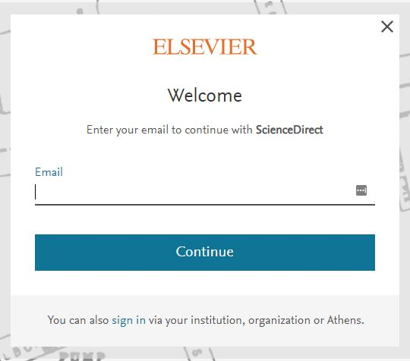
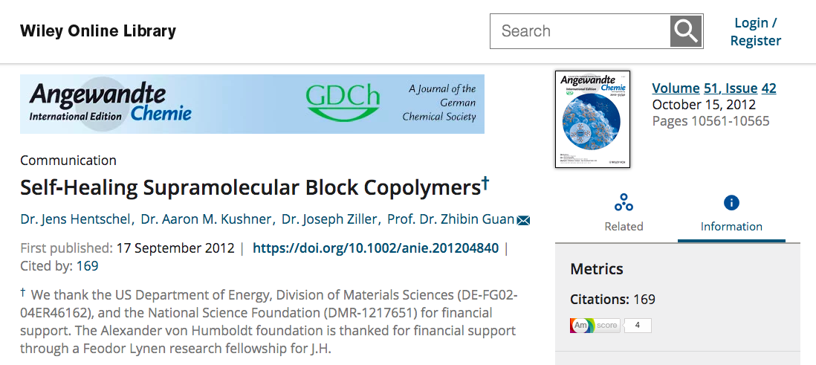
Login placement and language inconsistent across sites
#SeamlessAccess
Notes:
Users may not understand terminology like “institutional login”
The institutional login can be hard to find

Slide 41
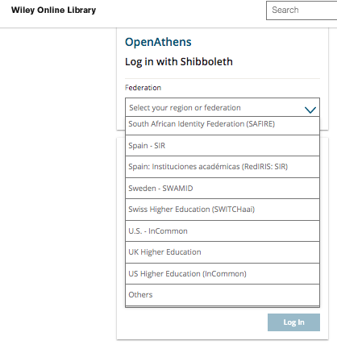
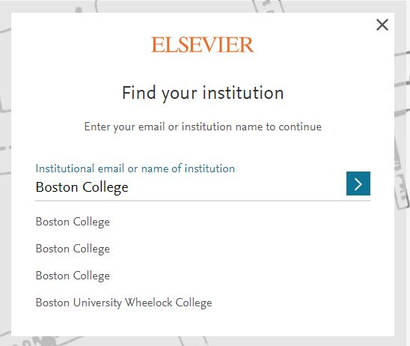
Authentication experience difficult to understand
#SeamlessAccess
Notes:
The authentication experience can feel quite different across different sites. So, let’s walk through how SeamlessAccess feels to a user.

Slide 42
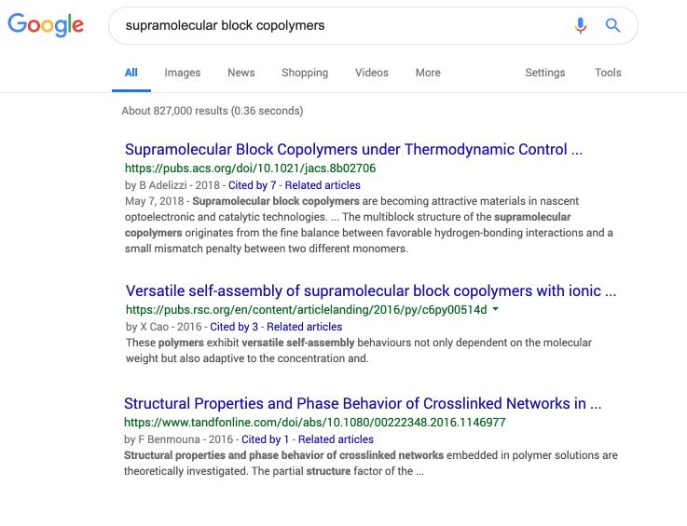
#SeamlessAccess
Notes:
Let’s use a typical use case of a user searching google for ‘supramolecular block co-polymers’. In this example, the first result is an ACS journal article

Slide 43
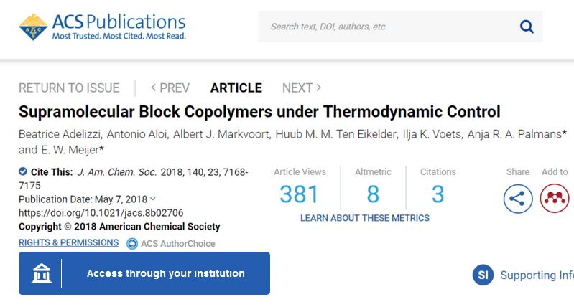
#SeamlessAccess
Notes:
Clicking on that article gets us to an article page where we’re invited to ‘Access through your institution’ using a standard SeamlessAccess login button.

Slide 44
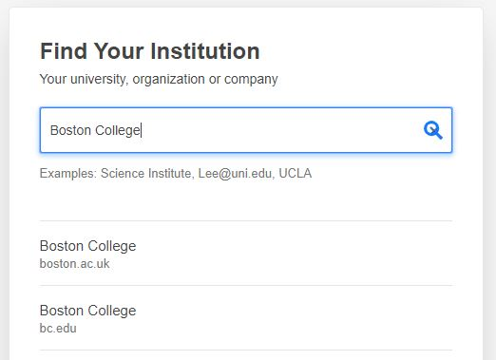
#SeamlessAccess
Notes:
Clicking on that button for the first time prompts us to search for our institution. As we type, a list is dynamically generated. In this case, we’re selecting Boston College as our institution.

Slide 45
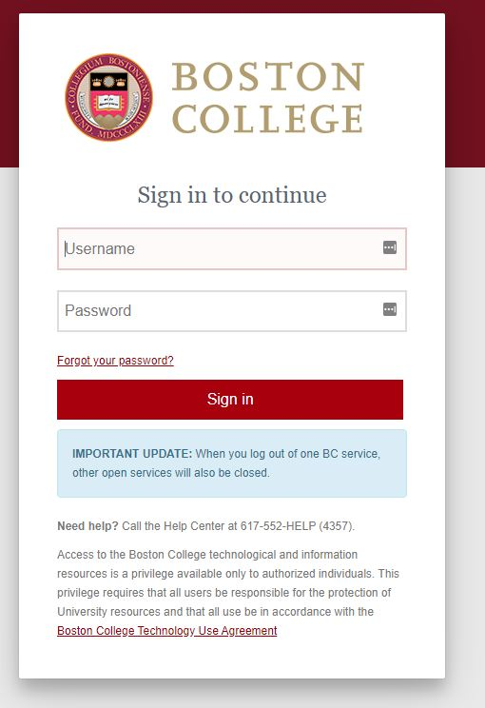
#SeamlessAccess
Notes:
We get forwarded to the Boston College Shibboleth software where we enter our Boston College credentials and are authenticated as a Boston College user

Slide 46
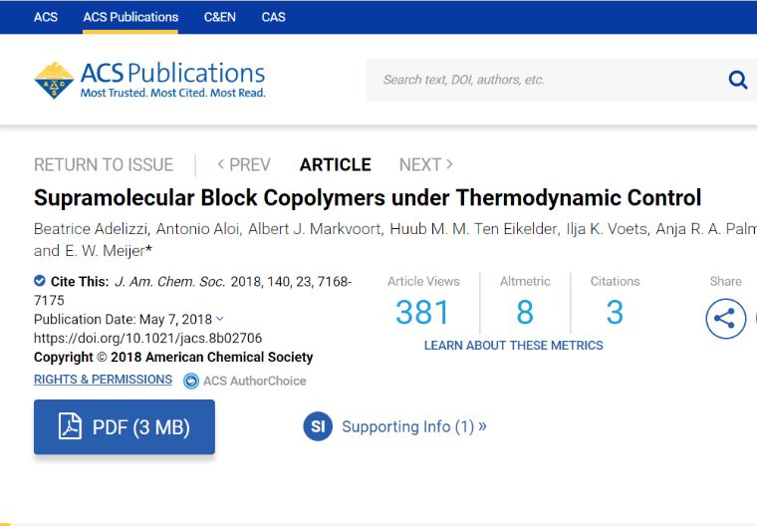
#SeamlessAccess
Notes:
We return back to that same ACS article page and, this time, the ‘Access through your institution’ button is replaced by a link to view the full text as a pdf.

Slide 47
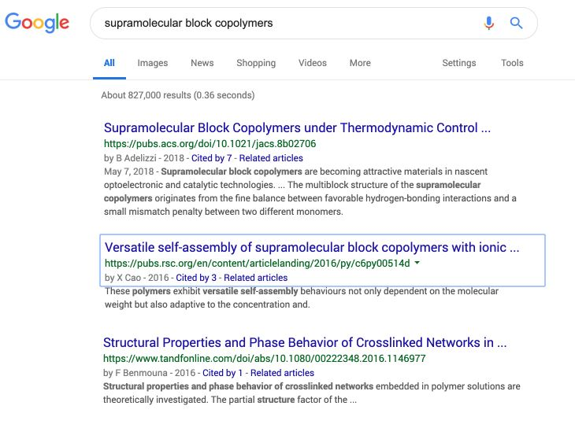
#SeamlessAccess
Notes:
Great, so let’s go back to our search results and try the 2nd result, which is a Royal Society of Chemistry article.

Slide 48
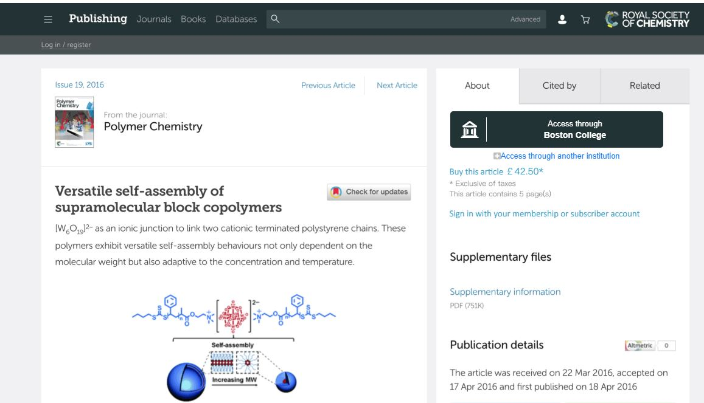
#SeamlessAccess
Notes:
When we arrive at the RSC journal article page, we see the same standard SeamlessAccess button to ‘Access through your institution’ except that, now, we’re offered the chance to access via Boston College. No need to repeat the same process to find our institution.
Note that underneath this button is an option to ‘Access through another institution’, in case I wear several hats and need to authenticate with one of my other institutional identities.
We’ll click to access and ….

Slide 49
#SeamlessAccess
Notes:
… seamlessly get to the full text.
Why? Because I’m already logged in to the Boston College network and so, behind the scenes, the SAML-handshake can proceed without me needing to re-enter my credentials.
It’s worth nothing one wrinkle to this, which is outside of the control of SeamlessAccess. Identity Providers control how long they maintain your session once you’ve logged in with your institutional credentials - it may be an hour; it may be a day. I’ve heard of some institutions that force re-entry every time … yikes.

Slide 50
Under the hood ...
Access button | Standard visual cue Generic vs customized message Option to re-select your institution
IdP Discovery Service | standardized, best-practice method to find your institution
Persistence Service | choices stored in Local Browser Storage Only accessible by SeamlessAccess.org User can opt out
#SeamlessAccess
Notes:
So, let’s look at what’s happening under the hood to enable this.
Firstly, SeamlessAccess has a standard visual cue for how a user accesses resources that require an institutional affiliation. This access button either displays a generic ‘Access through your institution’ message or a custom message listing your more recent institutional choice, if relevant. Users always have the option to re-select an alternative institution.
Secondly, the SeamlessAccess Identity Provider Discovery Service offers a standard method for finding your institution that incorporates best-practice design, such as dynamic search results as you type, alternative spellings and acronyms, and displaying institutional logos to simplify selection.
Thirdly, the SeamlessAccess Persistence Service stores your institutional choices on your computer in local browser storage. This information can only be accessed by applications coming from the SeamlessAccess.org domain, and aren’t stored remotely. And users will be able to opt out (which means they’ll need to select their institution every time they login).

Slide 51
What about Security & Privacy?
GEANT Data Protection Code of Conduct
Purpose limitation
Data minimization
Deviating purposes
Data retention
Similarly
ALA Code of Ethics, Article III.
#SeamlessAccess
Notes:
That all looks well and good, but what about Security & Privacy?
We’ve adopted the GÉANT Data Protection Code of Conduct, which provides specific guidance to Service Providers on how they should handle personal data in the context of federated authentication. It covers 4 fundamental principles: Purpose limitation, Data minimization, Deviating purposes, and Data retention
In a nutshell, Service Providers should:
only use attributes necessary for access;
use as little data as possible, wherever possible;
not do anything but provide access with this data;
delete/anonymize this data when it’s no longer needed.
The Code of Conduct document is remarkably readable and I recommend it to anyone interested in this area (there’s a link in the Slide notes: https://geant3plus.archive.geant.net/uri/dataprotection-code-of-conduct/V1/Documents/GEANT_DP_CoC_ver1.0.pdf)
It also aligns very closely with the American Library Association’s library privacy guidelines found in the ALA Code of Ethics.

Slide 52
What about Security & Privacy?
RA21 Security & Privacy Working Group
Comprised of librarians, technologists, publishers, NISO, OpenAthens, etc.
Assess technical security and data privacy risks
Provide recommendations / publish report
Conclusions (report completed July 2018)
No significant technical risks
No data privacy risks
Final report at ra21.org
#SeamlessAccess
Notes:
We’ve also audited our approach.
The RA21 project created a dedicated Security & Privacy Working Group to assess the technical security and privacy risks using industry-standard assessment models. This group was comprised of variety of stakeholders from across the information spectrum, and completed their analysis in July 2018:
For security, when applying standard security and data protection practices. No significant risks were found
For data privacy, a data protection impact assessment was performed compliant with the EU’s GDPR to determine if “high risks” were involved. None were found.
You’re welcome to read the full report at the RA21.org website (https://ra21.org/wp-content/uploads/2018/07/RA21-Security-Privacy-Final-Report.pdf)

Slide 53
Service Provider Integration Options
We’re testing 3 integration options during the Beta phase:
Limited
Standard
Advanced
The final integration options available will likely be simpler ...
#SeamlessAccess
Notes:
Now let’s look at how Service Providers integrate SA into their federated authentication experience. We’re testing 3 options during the beta phase: Limited, Standard, and Advanced. Service Providers will only be able to integrate once they’ve agreed to our Terms of Service, which we’re in the process of developing (and more on that later).
Note that the final integration options available at launch will likely be simpler.
Let’s explore the differences between them.

Slide 54
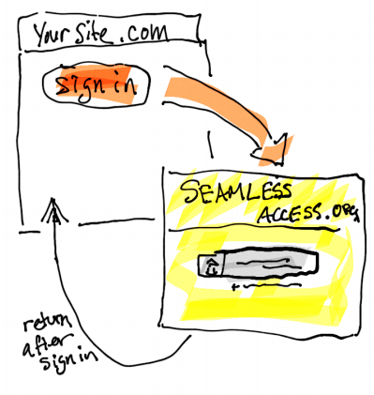
Service Providers - Limited Integration
Pros | Easiest to implement
Cons | Least seamless No branding or control over discovery experience
#SeamlessAccess
Notes:
In a Limited Integration, the Service Provider website simply sends users to the SA Identity Provider Discovery Service (service.seamlessaccess.org) to determine their preferred Identity Provider. SA does this either by identifying a previously stored choice in their local browser storage, or by asking them to select from a list. Then the user returns to the Service Provider site and their SAML solution manages the authentication process as normal.
It’s the easiest to implement - in Shibboleth, you simply configure SA as your Identity Provider discovery service.
However, this offers users the least-seamless experience because they are sent to the SA interface for Identity Provider discovery. As this gives the Service Provider no branding or control over this experience, we’re expecting this limited option to only be used in scenarios where an Service Provider is unable to use the standard integration e.g. they don’t have the necessary control over the website or SAML solution.

Slide 55
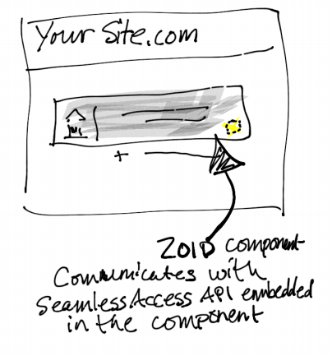
Service Providers - Standard Integration
Pros | Embed process within SP branding & experience
Cons | Requires more control over SP website to implement
#SeamlessAccess
Notes:
A Standard Integration is essentially the same process except that the Identity Provider discovery experience is embedded within the Service Provider’s existing web experience.
This requires more control over the Service Provider application to implement, but is not particularly complex. It’s ‘standard’ because we expect most Service Providers to opt for this method as it offers a nice balance of simplicity and control.
Notes: ZOID is a javascript library toolkit to simplify safe, cross-domain scripting]

Slide 56
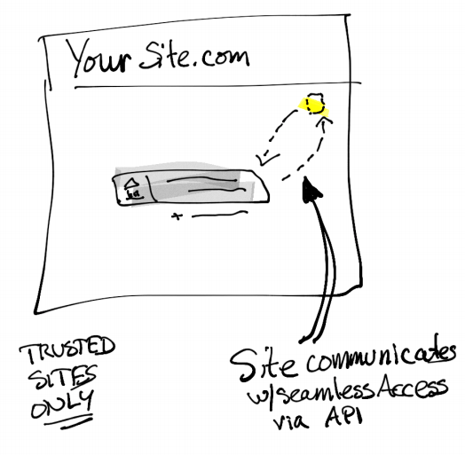
Service Providers - Advanced Integration
Pros | More control over login & IdP discovery UX
Cons | Significantly more complex to implement
#SeamlessAccess
Notes:
The Advanced integration offers Service Providers more granular control over their login and discovery user experience. For example:
Customize the user workflow e.g. to display extra info/steps after certain actions (vs the default workflow from SA)
Customize the list of Identity Providers available in the discovery phase (vs the default list from SA)
Customize the visual look of the login button within specific parameters (vs the default button from SA)
The API access enabling this more advanced configuration is only available to a set of ‘trusted sites’ i.e. whitelisted applications
However, these options can be significantly more complex to implement because of the more specialist technical knowledge required.
Notes: whitelisting currently by domain but more secure options will be available for launch

Slide 57
3. What’s the current status?
Notes:
Ok, now let’s walk through the current status of SeamlessAccess

Slide 58
We’re in the beta phase ...
Testing our ideas in practice
Soliciting feedback to help improve our solutions
Changing our approach as needed
This is not a fully-developed service yet ...
#SeamlessAccess
Notes:
We’re in that beta phase that you saw from my earlier timeline slide. This means we’re:
We’re testing our ideas in practice
We’re soliciting feedback to help improve our solutions
We’re changing our approach as needed
We’ve got live implementations in progress because we need to test the service with real users in order to fully understand how it works in the real-world and to iron out the kinks.
This is not a mature, fully-developed service yet …

Slide 59
Beta Implementation Status
 | Library Resources | Research Collaboration | Other
Live | SpringerNature |  | SAFIRE (test)
In progress | ACS, Elsevier, Digital Science
In planning | WIley, O’Reilly, Taylor&Francis, CCC | DARIAH, UNiDAYS | Atypon, Silverchair, CAR
#SeamlessAccess
Notes:
This slide shows you organizations that are currently working on a beta implementation, with their org type along the top and their implementation status down the lefthand side. As you can see, we’re currently live with 2 implementations (SpringerNature and SAFIRE).
Note that while most of these organizations are library resource providers (green column), we also have a couple of examples of research collaborations, as well as some platform providers and an Internet2 initiative.
Notes:
DARIAH: Digital Research Infrastructure for the Arts and Humanities (DARIAH) - a network to enhance and support digitally enabled research and teaching across the Arts and Humanities
UNiDAYS: Student affinity network with 13m+ registered students across 100+ countries
SAFIRE: national academic identity federation for the South African research and higher education community.
CAR: Consent-informed Attribute Release - an Internet2 initiative

Slide 60
Attribute Release Working Group
Identify categories of scholarly resource use cases
develop standard attribute release profiles
currently in progress
#SeamlessAccess
Notes:
We’ve also got a couple of cross-industry working groups helping us develop best practice recommendations. The first is the Attribute Release Working Group
Task is to identify distinct categories of scholarly information resources and users, determine their needs, and develop standard attribute release policies and profiles applicable to each category. Once agreed, we want these categorizations and profiles endorsed and adopted by global research and education federations, library communities, and other stakeholder groups
Example categories include library walk-ins, hospital/clinical settings, research collaborations, and corporate libraries.
This group includes >20 members from across industry stakeholders incl. Service Providers, Identity Providers, libraries, federations, and consultants
The end goal is to greatly simplify the process of configuring Service Provider access for Identity Providers, lowering costs and minimizing the risk of errors.

Slide 61
Attribute Release Working Group
Draft recommendations (work in progress)
3 new entity categories
Self-asserted by the Service Provider
Identity Provider chooses whether to support
#SeamlessAccess
Notes:
Hot off the presses following recent meetings, we have some draft recommendations that I can share with you. Please note that this is work in progress, and nothing will be completed until it goes through a broad community consultation phase.
The draft recommendation is for the creation of 3 new entity categories.
These categories would be asserted by the Service Provider.
And, unlike the Research & Scholarship entity category that we mentioned earlier, which is controlled at the federation level (Identity Providers either implement it for any Service Provider or for none), these entity categories would be controlled at the local institutional level. This means that each identity provider can choose whether or not to accept them for individual Service Providers.

Slide 62
Attribute Release Working Group
Draft recommendations (work in progress)
Anonymous access | No attributes needed thanks!
Pseudonymous access | Pseudonymous identifier Entitlement/affiliation e.g. faculty, student
Personal access | Personal data e.g. name, email address Entitlement/affiliation e.g. faculty, student
#SeamlessAccess
Notes:
The 3 proposed new entity categories nicely match the attribute types from one of my earlier slides.
The Anonymous Access category would be used by a Service Provider who doesn’t need any user attributes. Just confirmation of their organizational affiliation.
The Pseudonymous Access category would be asserted by a Service Provider who needs to personalize their service, and would also allow for additional entitlement and affiliation data that could provide more control over access, such as a user’s role (faculty vs student).
And the Personal Access category would be asserted when a Service Provider needs personal data, such as a name and email address, in addition to the entitlement and affiliation data. This category would assume an appropriate contract is in place between the Service Provider and Identity Provider. As will all these categories, the Identity Provider remains in control and can decide whether or not to support it.

Slide 63
Contract Language Working Group
Develop templates based on attribute release
Mechanism to ensure compliance
follow-on project starting later in Spring
#SeamlessAccess
Notes:
Our second working group is the Contract Language Working Group
Task is to develop contract language templates for library use based on Attribute Release/Entity Descriptions from above
This give libraries a mechanism to ensure Attribute Release compliance
Still collecting members and will start work once the Attribute Release recommendations are ready, later in the Spring

Slide 64
What we’re working through
T&Cs for Service Providers
User Consent workflow
Access to IdP choices prior to authentication
Personal Data
Feature requests e.g. ability to customize list of IdPs
#SeamlessAccess
Notes:
Finally, here are some examples of the sorts of issues we’re currently working through.
T&Cs for Service Providers
We’re finalizing the T&Cs that Service Providers will be required to sign in order to use the SA service. These will control how they can use the service, including the user’s institutional choices, and include the ability to deny access to SPs that abuse the service.
Every Service Provider needs to be registered with a federation
User Consent workflow
We’re working on the user consent workflow to enable users to opt out of storing their institutional choice in their local browser storage. Opting out simply means your Service Provider will need you to identity your institution each time you login. We’ll also flag if access to your local browser storage is blocked (intentionally or not) and we’re unable to store your institutional choice.
Access to Identity Provider choices prior to authentication
Unintended feature arising from the flexibility available under the Advanced Integration
Exploring ways to address this incl. changes to the advanced API, expanding consent requirements, and clearer prohibitions on use within Service Provider T&Cs
More at https://seamlessaccess.org/general/2020/01/13/clarifications/
Personal Data
Our collective understanding of what constitutes Personal Data has changed over the life of the project. The EU’s GDPR regulations only came into force 2 years after the initial RA21 project started in 2016, and since then technologies such as browser fingerprinting have greatly expanded the information that enable organizations to identify an individual. As a result, we’re investigating 2 possible areas where the data we store may fall within the definition of Personal Data.
The first is that the institutional choices we’re storing locally (in the form of SAML entity IDs) may be classified as PD when combined with other information held by Service Providers.
The second is that user IP addresses may be PD when they can be tied back to an individual, rather than an institution. While we don’t formally store IP addresses, they do persist within server logs used in our cloud-based infrastructure.
As a result, we’re carefully reviewing our approach to fully understand the implications before deciding what steps we need to take.
Feature requests
An example is the ability to customize the list of institutions that users can search within. For example, to exclude organizations that don’t have access, or add in additional organizations that aren’t listed.
NOTES: the SA IdP list is generated from eduGAIN, so an SP ideally needs to be in eduGAIN and accepts all the SPs in that list. Currently, there’s no way to filter/supplement that list, so SPs that want to add additional IdPs and/or filter out certain IdPs would need to use the Advanced integration

Slide 65
4. How do I participate?

Slide 66
Next steps for Service Providers
Visit https://seamlessaccess.org/work
Contact us:
Heather Flanagan
Laura Paglione
contact@seamlessaccess.org
#SeamlessAccess
Notes:
If you’re a Service Provider interested in finding out how to make your access experience more seamless, please visit our website (seamlessaccess.org/work) and contact either Heather or Laura at contact@seamlessaccess.org

Slide 67
Next steps for Identity Providers / Libraries
Plan for transition
Is SAML supported at your institution?
Privacy policies and attribute release
Working with IT
Evaluate vended solutions
Get involved
#SeamlessAccess
Notes:
If you’re an Identity Provider wanting your users to benefit from more seamless access, then you simply need to support federated authentication. Nearer the launch date, we’ll provide more information and materials to help inform users about the forthcoming improvements to their access experience.
If you don’t already support Federated Authentication, then you’ll need to plan for a transition. As with any other software implementation, you’ll likely want to talk to your IT department, evaluate vended solutions, understand your organization’s privacy policies etc.
We’re aware this can get complex, and we’re working to simplify that process by standardizing approaches to attribute release and contract language.

Slide 68
Next steps if you want to learn more
Sign-up for our monthly email updates
Join a working group
contact@seamlessaccess.org
#SeamlessAccess
Notes:
Finally, if you just want to learn more as an individual, please sign up for our monthly email updates and consider joining the Contract Language working group. Contact us at contact@seamlessaccess.org.

Slide 69
thank you!
contact@seamlessaccess.org

Slide 70
User Consent Workflows
Un-check box to opt out
Access to local storage blocked
Click to ‘Learn more’
#SeamlessAccess

Slide 71
GetFTR
A new, free to use service designed to enable faster access to published research
GetFTR enables discovery services to flag content that a user has access to via their institution
SA is one of the ways that a SP can determine a user’s organizational affiliation
An example of the sort of tool that can benefit from SA, and we expect there to be many others developed in future.
#SeamlessAccess
Notes:
Future tools like GetFTR will likely target more specific issues, workflows, and segments of the market.
https://www.getfulltextresearch.com/

