Slide 1
ERM Systems: Emerging Trends, and Opportunities for Publisher/Vendor Partnerships
Lola Estelle and Peter McCracken
2/23/2020

Slide 2
ERM Systems: Emerging Trends, and Opportunities for Publisher/Vendor Partnerships
About Lola and about SPIE Digital Library
What Lola will talk about today . . .
  ERM systems: a quick look at the past, present, and future
  How publishers can work with ERM vendors to help serve libraries
    Examples
    Challenges
Then Peter will discuss opportunities presented by FOLIO

Slide 3
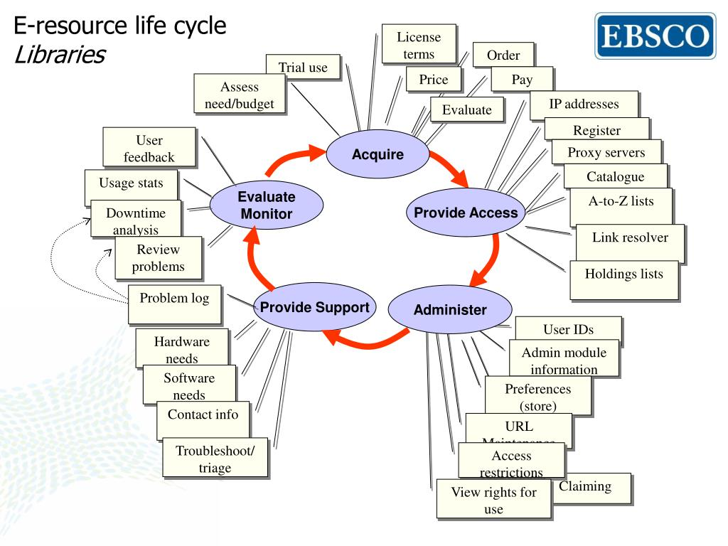
Pesch, O. (2009). ERMs and the e-resource life-cycle [Powerpoint slides].

Slide 4
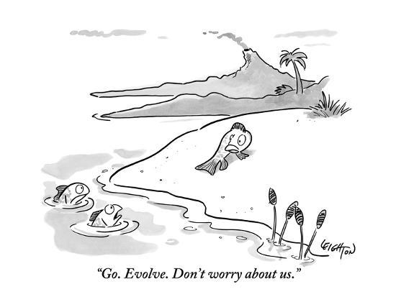
Leighton, Robert. (2010). Cartoon from The New Yorker.

Slide 5

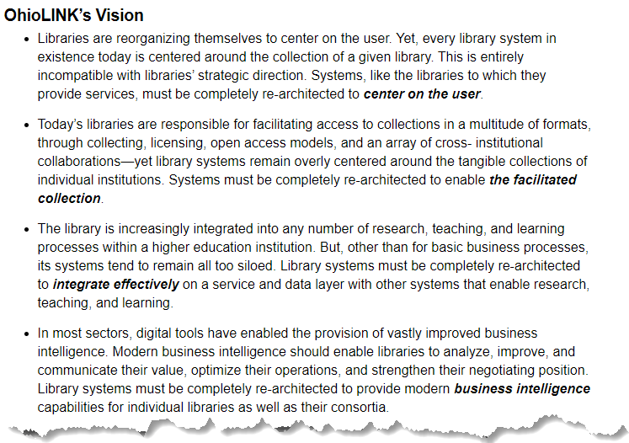

Slide 6
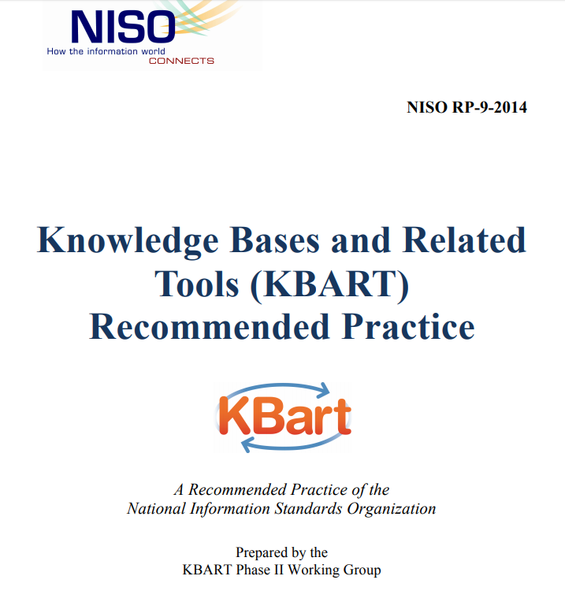

The Knowledge Base and KBART

Slide 7
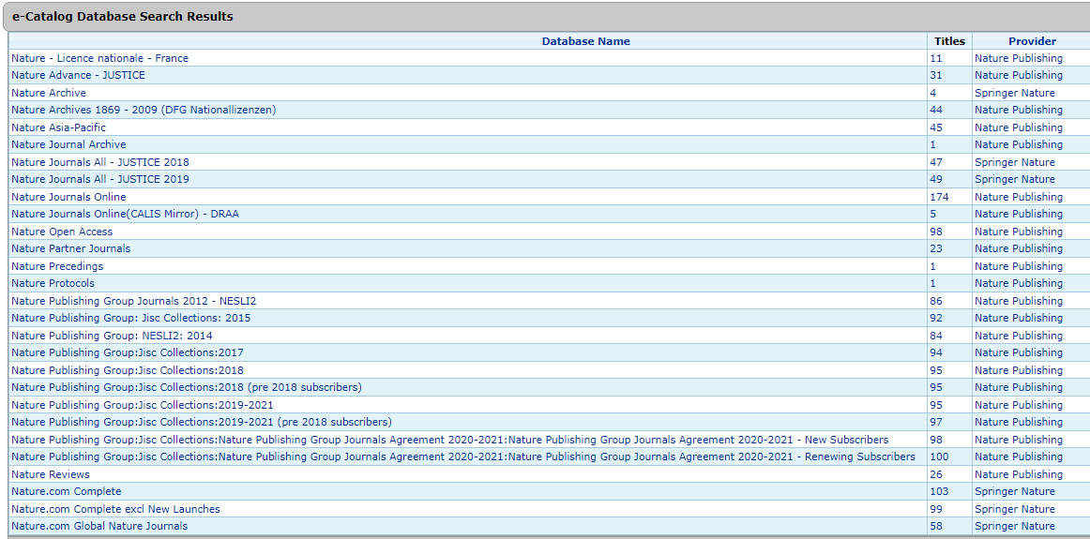
“Which package do I activate in the Knowledge Base?”

Slide 8
Pesch, O. (2009). ERMs and the e-resource life-cycle [Powerpoint slides].

Slide 9
“Which package do I activate in the Knowledge Base?”

Slide 10
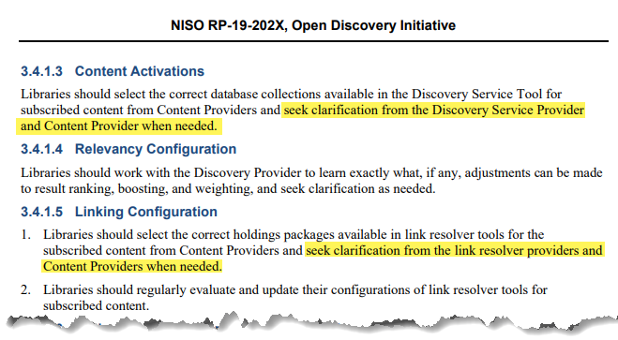
From the revised NISO Open Discovery Initiative Recommended Practice, now available for public comment . . .

Slide 11
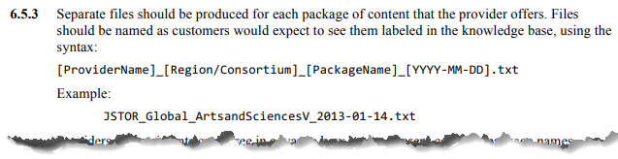
Challenges for content providers who wish to provide guidance around knowledge base content package selection . . .
Resources!
  Properly named KBART files
  Developing staff expertise
  Creating/maintaining documentation
Insight into how their content packages are listed in knowledge bases
  Guest access to knowledge base
  Specialized vendor dashboard
  Documentation on knowledgebase vendor websites
  Information otherwise provided by vendors
  Open source knowledge bases

Slide 12
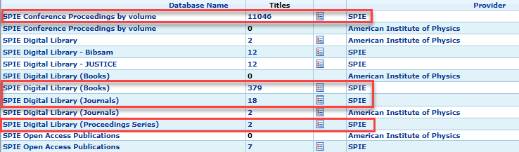
SPIE content in ExLibris Knowledgeworks

Slide 13
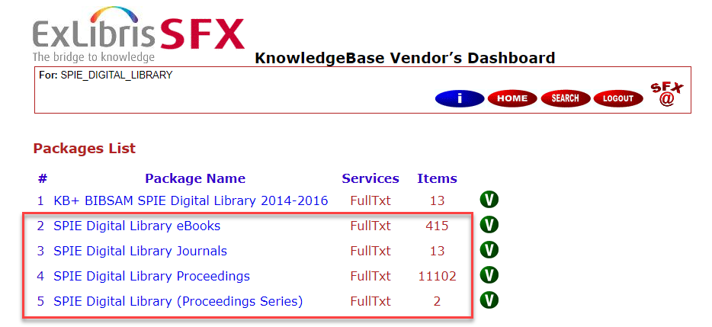
SPIE content in SFX knowledgebase

Slide 14
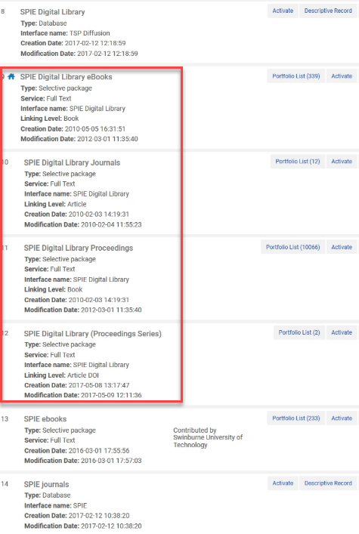
SPIE content in Alma Community Zone

Slide 15
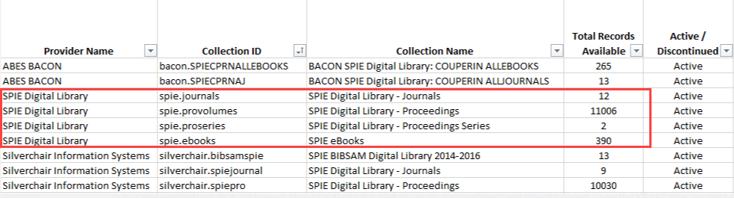
SPIE content in WorldCat Knowledgebase

Slide 16
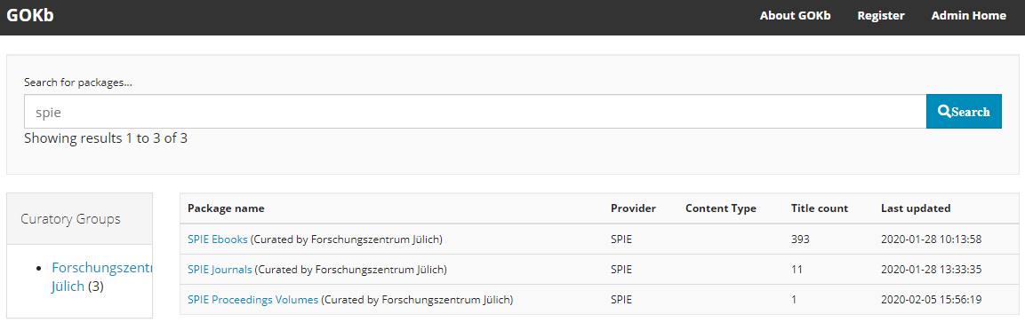
SPIE content in GOKb

Slide 17
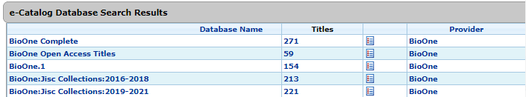
BioOne content in ExLibris Knowledgeworks

Slide 18
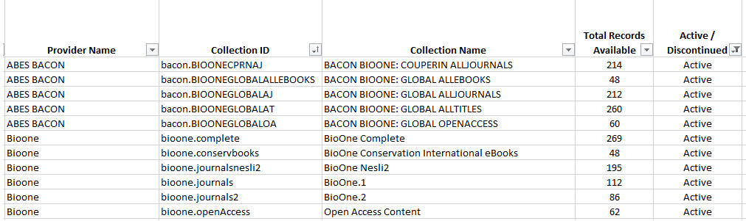
BioOne content in WorldCat Knowledgebase

Slide 19
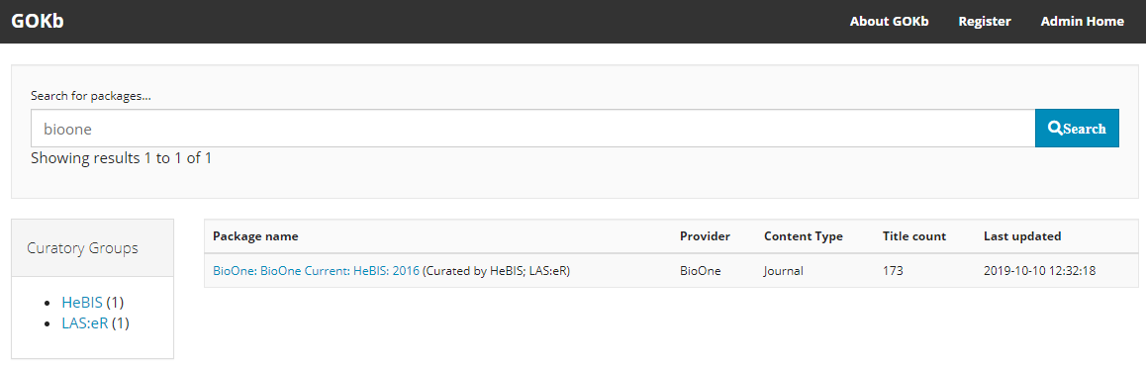
BioOne content in GoKB

Slide 20
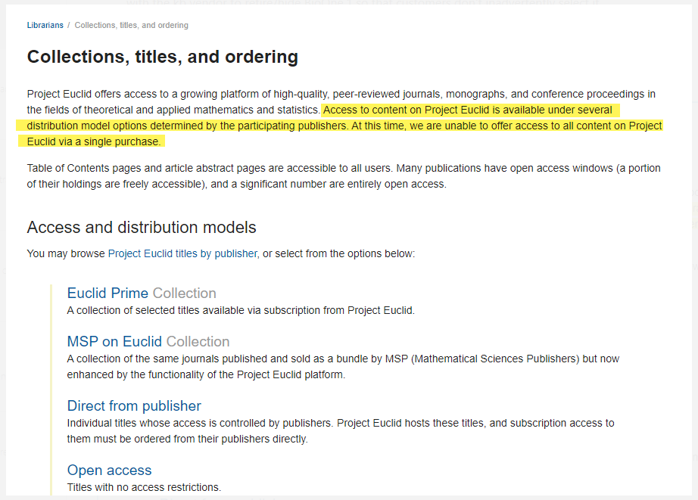
Project Euclid content packages according to Project Euclid’s webpage

Slide 21
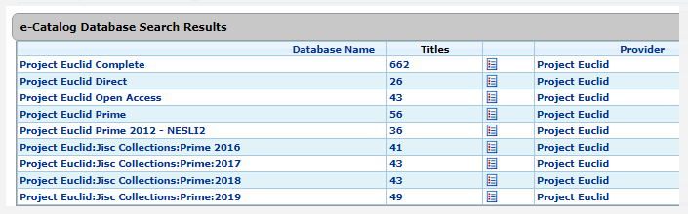

Project Euclid content in ExLibris Knowledgeworks

Slide 22
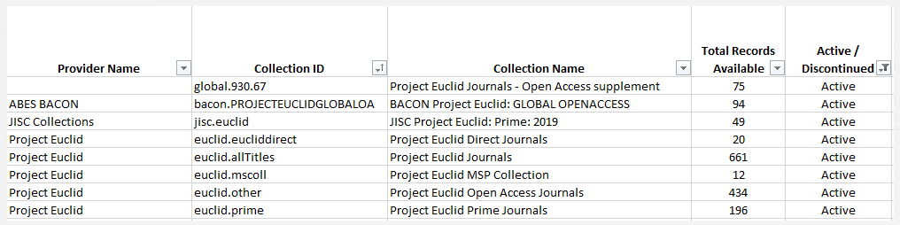
Project Euclid content in WorldCat Knowledgebase

Slide 23
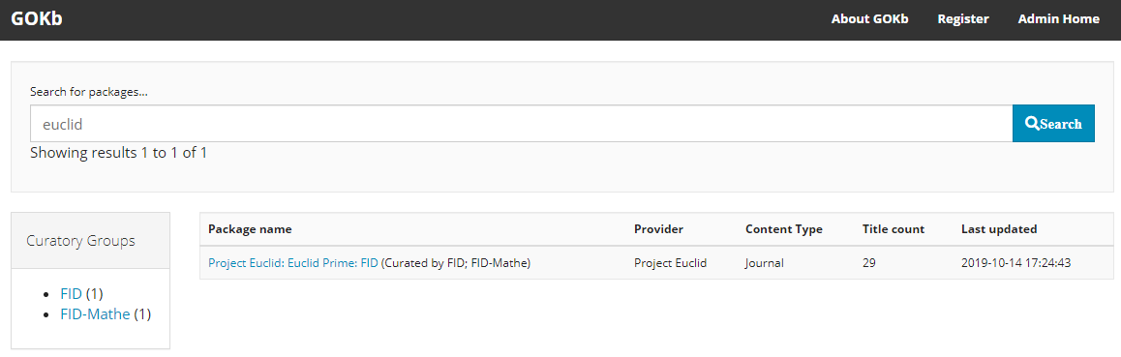
Project Euclid content in GOKb

