Slide 1
The Future of E-Resources Management: FOLIO ERM
Peter McCracken Acquisitions & E-Resources Strategy Librarian
Cornell University Library
23 February 2020

Slide 2
ERM Background at Cornell
Using Voyager, for nearly 20 years
Blacklight layer on top of Voyager for about six years
ProQuest/Serials Solutions tools for last 10-15 years, including Intota from 2015 to 2019
III ERM before that, ca.2004 to 2015
Not excited by Alma; what other options existed?
Joined OLE just before it pivoted to FOLIO

Slide 3
FOLIO Background
FOLIO = The Future Of Libraries Is Open
An open source library services platform
Open source: freely downloadable software, useable by anyone
“FREE”: Think “free puppy”, not “free beer”
Provides back-end library services:
Circulation; acquisition; patron management; cataloging; vendor management; etc.
No patron-facing interface – we use Blacklight on top of Voyager at present; will continue to do so

Slide 4
FOLIO: How is it different?
Actually, truly, honestly – for real, this time – designed by librarians
Special Interest Groups (SIGs) provide constant and continual feedback to product owners and developers
Truly open development
Anyone can participate in development, or watch recordings of practically every SIG meeting, sprint review, and more
Regular outreach programs with updates on development
Choose a vendor to support your implementation, not the product

Slide 5
FOLIO Organizational Structure
Product Council
Technical Council
Privacy
Reporting
Consortia
International-ization
Reporting
User Access & Management
SysOps & Management
Resource Access
Resource Management
Metadata Management
Accessibility
Loans
Reserves
eHoldings
Batch Loader
Public Library
Printing Slips
ERM
Inventory App
Requests
Tags
MARCcat
Calendar

Slide 6
FOLIO at Cornell - Development
Many leadership and development roles in FOLIO
Chair of Product Council
Project Manager, Open Library Environment
Convener of Metadata Management SIG
Convener of Reporting SIG
Membership in every SIG except Consortia and Public Library
Between 4 & 6 developers committed to writing FOLIO code

Slide 7
FOLIO at Cornell - Implementation
Cornell went live in October 2019; expanded work began in last two weeks
Now populating FOLIO ERM
Agreements, licenses, organizations
Full FOLIO coming in July 2021
Circulation, acquisitions, cataloging, organizations (CRM), etc
In October, we decided to delay from July 2020 to July 2021

Slide 8
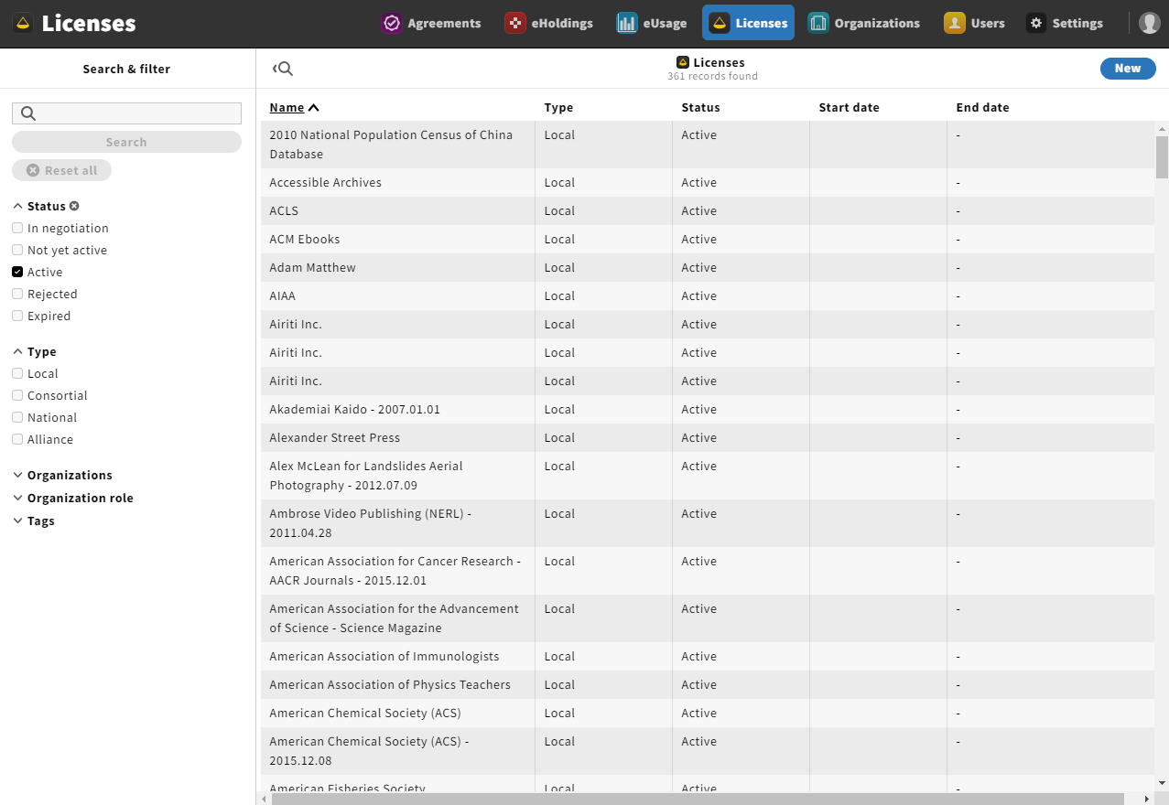
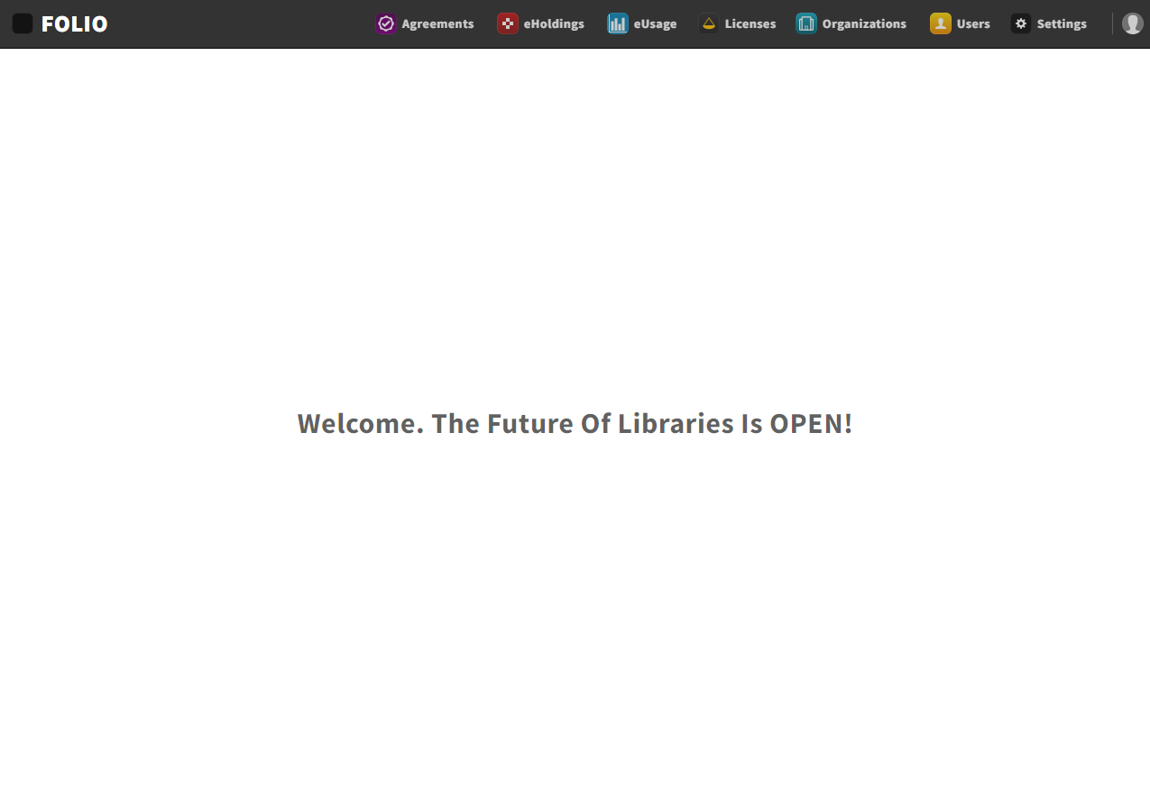
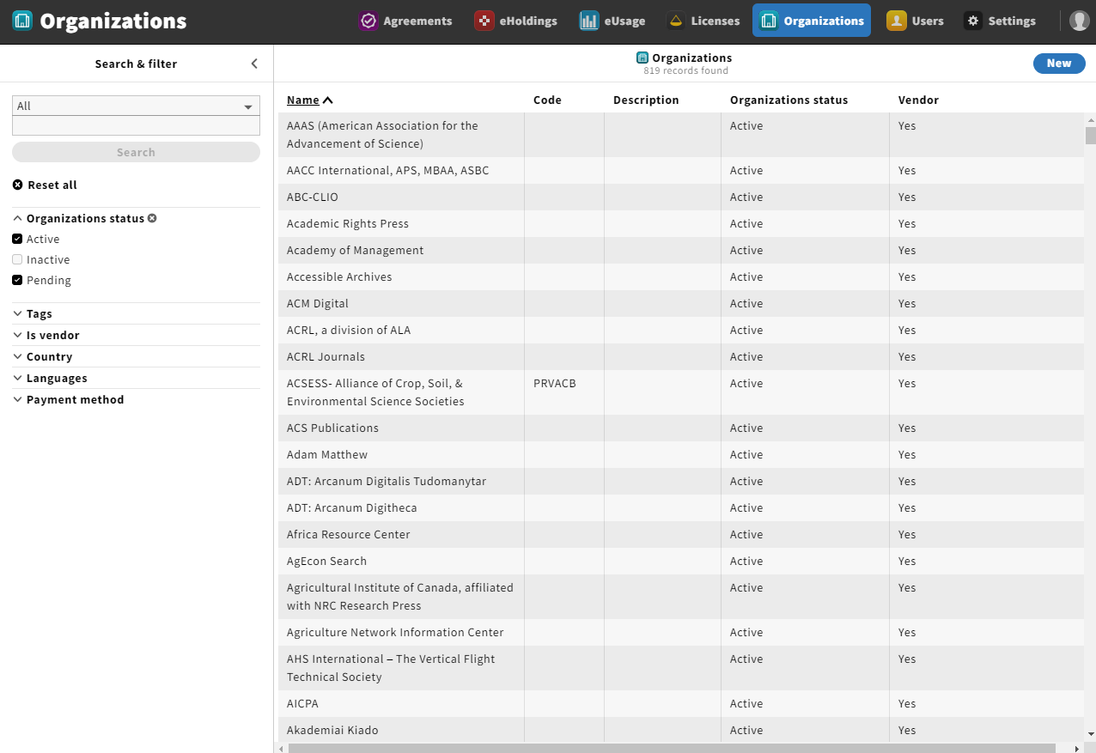
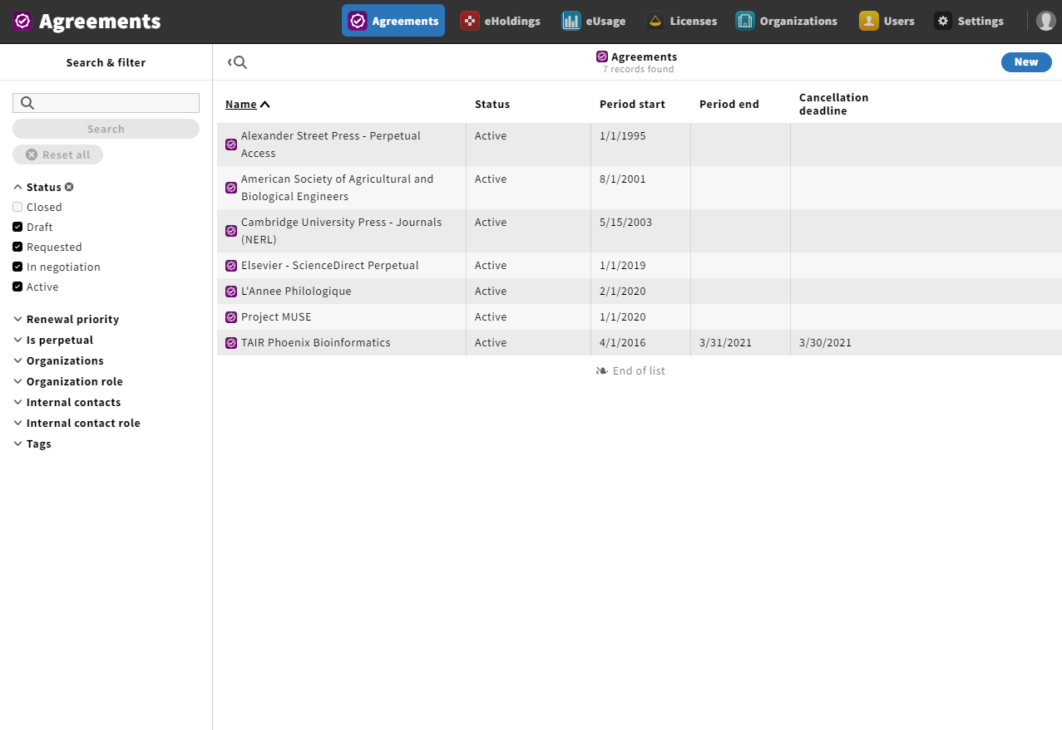
Screen Shots / Examples

Slide 9
Screen Shots / Examples

Slide 10
Why it Matters (to me)
A true paradigm shift in library software development
Continual interactions with librarians, vendors, developers, product managers, and others
Build or contract for solutions not otherwise available
A true community to make it succeed
Large enough now to survive if some choose to end support or participation
Continually growing; anyone can implement
A financially responsible and viable solution

Slide 11
Thanks for your time and attention.
Questions? Comments? Thoughts?
Peter McCracken phm64@cornell.edu

